Slide 1

Strangulation of Women
Kathryn Laughon, PhD, RN, FAAN
Associate Professor
University of Virginia School of Nursing

Slide 2
Strangulation Statute
§ 18.2-51.6- Strangulation of another; penalty
“Any person who, without consent, impedes the blood circulation or respiration of another person by knowingly, intentionally and unlawfully applying pressure to the neck of such person, resulting in the wounding or bodily injury of such person is guilty of strangulation, a Class 6 felony.”

Slide 3
Clinical Definition:
A form of asphyxia characterized by closure of the blood vessels or air passages of the neck as a result of external pressure on the neck
Statute says “impede the blood circulation or respiration of another person” so parallel
  Often improperly described as “choking,” which is an internal blockage of the airway.

Slide 4
38 states + federal government now have specific strangulation statutes.

Slide 5
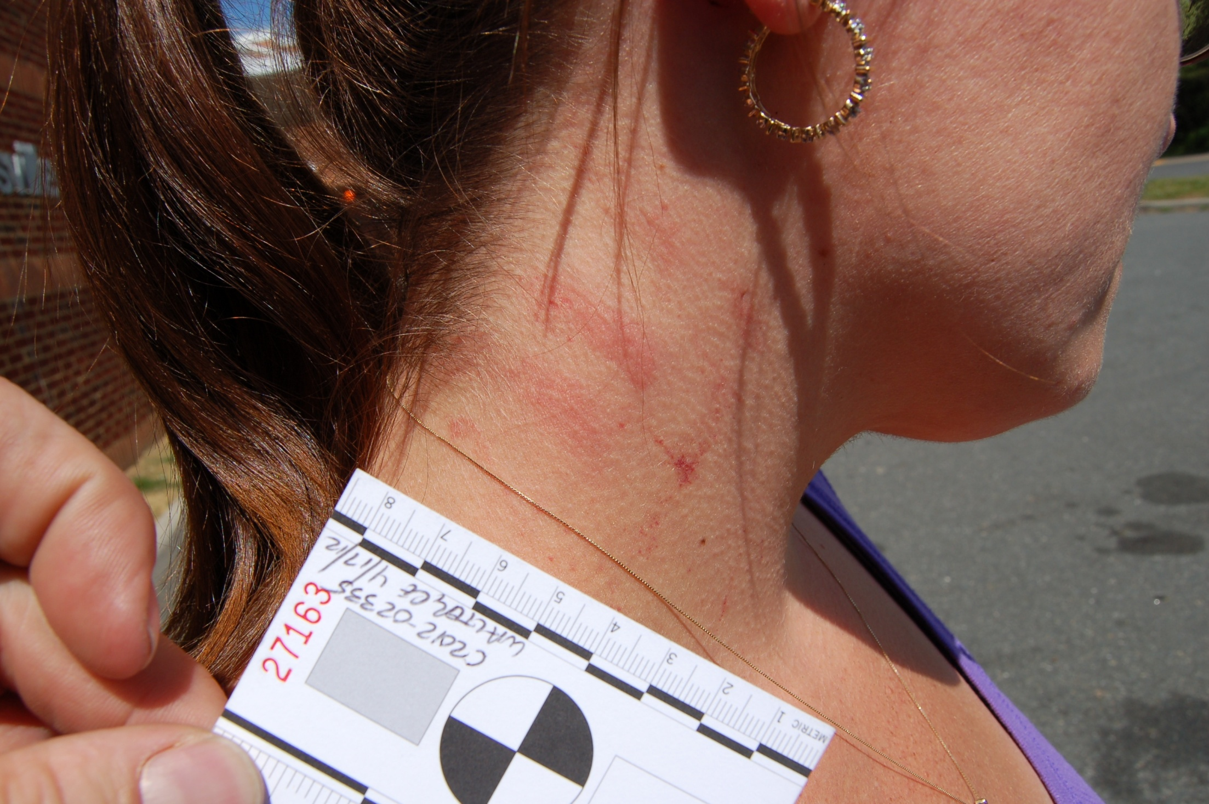
Notes:
Does the force it took to cause this look like more than an A&B?

Slide 6
Why the attention on Strangulation?
Can be fatal:
  Immediate causes of death: asphyxia, stroke or cardiac arrest
  Delayed causes: including carotid dissection, laryngeal edema, pulmonary edema, aspiration pneumonia
  Funk & Schuppel, 2003; McClane et al., 2001
Notes:
Our last two domestic homicides had serious strangulation episodes in both relationships. Most abusers don’t strangle to kill, they strangle to show they can kill.

Slide 7
strong predictor for subsequent lethal violence
  Survivors of nonlethal strangulation are 7x as likely to become a homicide victim (usually not through strangulation) (Glass et al, 2008).
  Examples: Charlottesville saw two IP femicides in 2010 – both had strangulation history from the assailant.

Slide 8
Assailants who strangle may be more dangerous in other ways:
  Unpublished data from Riverside CA of intentional shootings of police found 50% of assailants had a history of committing strangulation

Slide 9
Incidence
47-69% of women evaluated for IPV report being strangled (Bullock et al, 2010)
  Strangulation is the 3rd most common cause of dv homicide in the U.S.
80-90% of strangulation of women within IPV. The remaining cases almost always associated with sexual violence (Shields, et al, 2010)
Implication: Most women who are strangled by an intimate partner report multiple strangulation victimizations

Slide 10
Local Incidence
VA Data: 2011 VSDVAA Statewide Data Collection system:
42% of IPV victims presenting to shelters/agencies disclosed that a “perpetrator blocked or obstructed” their breathing.
In 2009, family and IPV accounted for 1/3rd of all Virginia homicide victims. (n=410)
Here in Charlottesville:
  In 2011, 36% of our Domestic Assault cases involved strangulation (Charlottesville)

Slide 11
Pathophysiology of Strangulation
laryngotracheal injuries, digestive tract injuries, vascular injuries, orthopedic injury and neurological insult
Panic and pain, followed by unconsciousness with occlusion of blood vessels
Neck muscles protect arteries, then with LOC, muscles relax and same force will occlude arteries
Then possible to collapse airway
Death can occur through reflex cardiac arrest (rare) and through asphyxia (4-5 minutes) or stroke
(Green, 2013; Taliaferro et al., 2009; Wilbur et al., 2014)

Slide 12
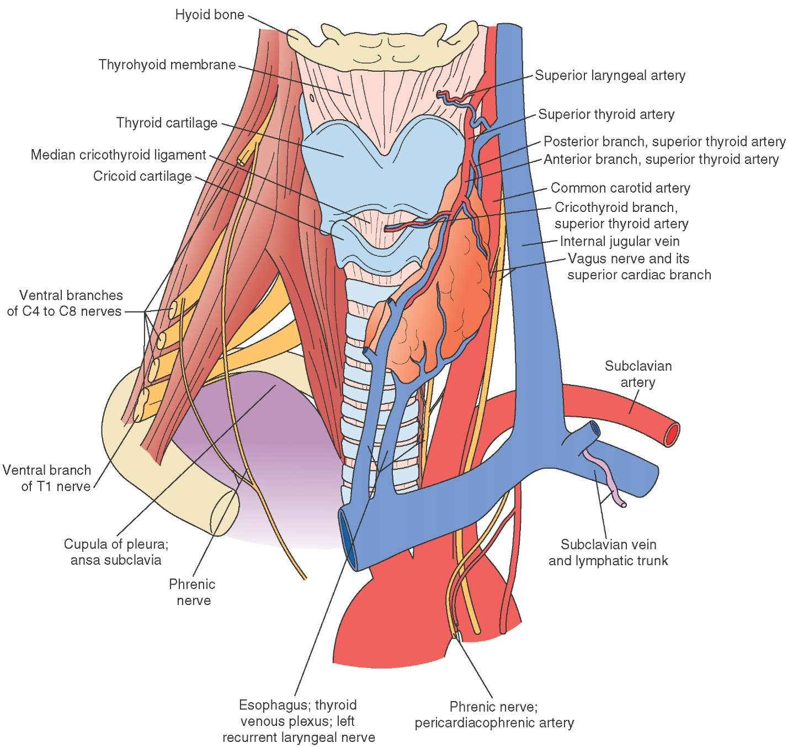
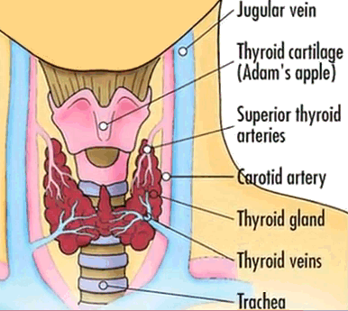

Slide 13
Minimum Pressures
  4 lbs – Jugular Occlusion
  11 lbs – Carotid Occlusion
  33 lbs – Crush Trachea
Lethality depends on surface area, amount of pressure, location of pressure, and amount of time.
(Green, 2013; Taliaferro et al., 2009, Wilbur et al., 2014)

Slide 14
Significant Sequelae for Victims
Affects multiple systems: musculoskeletal, respiratory, GI, cardiovascular, neurological & psychological

Slide 15
Musculoskeletal
Injuries to muscles and bones in the face and neck
  Fractures
  Bruising
  Swelling
  Hemorrhages

Slide 16
Cardiovascular
Carotid arteries, jugular veins, other vessels
  Carotid dissection (immediate or late effects) as pushed against cervical vertebrae (5 lbs of pressure needed)
  Occlusion of carotids will cause anoxia and brain death (11 lbs of pressure)
  LOC can occur within 10 seconds
  Victim may not regain consciousness immediately

Slide 17
occlusion of jugulars (4 pounds) w/o occlusion of carotids – buildup of venous pressure, bursts small vessels (petechiae)
  petechiae in brain and in face/head/eyes above area of occlusion

Slide 18
Respiratory System
Larynx & trachea
Injuries
  Cartilage fractures
  Subcutaneous emphysema
  Soft tissue swelling resulting in airway compromise
  Aspiration pneumonia (delayed)
  Laryngeal edema (can be delayed)
  Dysphonia (speech changes)

Slide 19
Can completely occlude larynx (anoxia and brain death within 4-5 minutes) but requires 33 lbs of pressure

Slide 20
Gastrointestinal system
Mouth & Esophagus
  Dental trauma
  Lacerations to lip/inside cheek
  Tongue bites & edema
  Esophageal swelling and/or bleeding
  Dysphagia (difficulty swallowing)
  Nausea & vomiting

Slide 21
Neurological system
Brain, vagal and peripheral nerves
  Dysphagia and dysphonia (can be permanent)
  Tinnitus
  Nausea and vomiting
  Petechiae in brain
Notes:
Crazy old researcher in the 1940s used blood pressure cuff to strangle people – with schizophrenia and normal volunteers – very consistent visual changes/sensations

Slide 22
  Visual changes: narrowing of visual field, fixation of eyes, blurring vision, LOC, convulsions, loss of bowel and bladder control
  “his eyes were black”

Slide 23
Repeated instances of strangulation may lead to permanent brain injury
(Green, 2013; Taliaferro et al., 2009)

Slide 24
Psychological
Significant association with PTSD, even compared to other forms of IPV
Agitation or flat affect can occur immediately after the attack (may be combination of anoxia & psychological trauma)
(Strack, 2000; Wilbur, 2008)

Slide 25
Documentation of injuries
Careful documentation of symptoms and injuries is key
  In NY after strangulation law was passed, almost 1500 2nd degree strangulations were charged – 20 went to trial
  In Maricopa County AZ, 50 cases of strangulation/7 charged in year after new law passed
  New program piloted (police training + forensic exam): 41 cases in 3 months, 31 forensic exams, 26 charged, all successful.

Slide 26
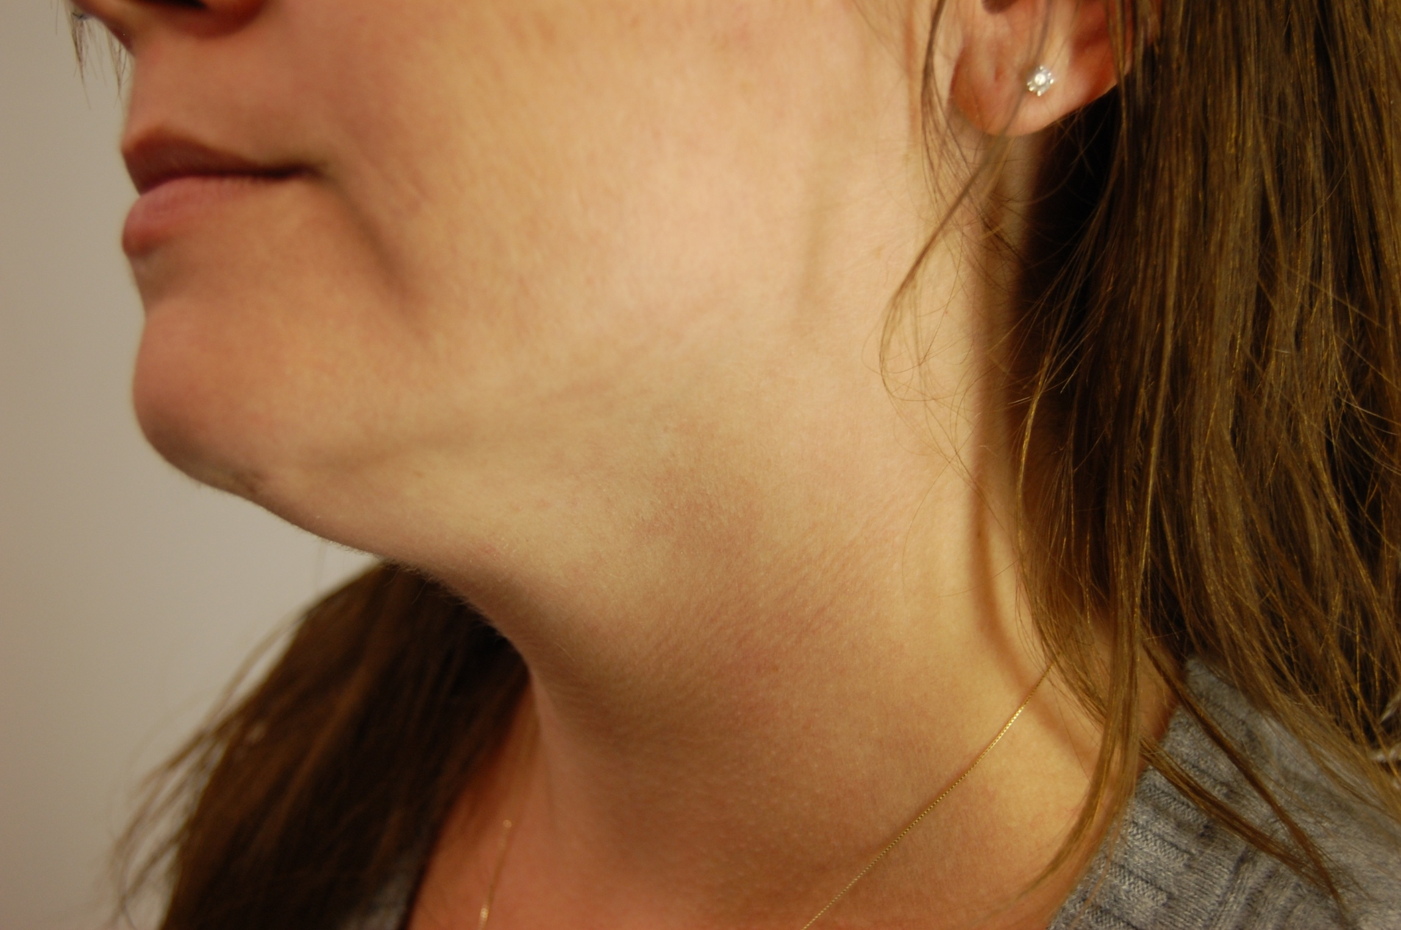
Notes:
Picture take day later still shows red mark along neck

Slide 27
Injuries
Defensive injuries on victim
Offender may be injured as the victim tries to defend self
  Scratch marks on face, hands and/or arms with frontal strangulation
  Bite marks on hands when mouth is covered or attempted to cover during chokehold
  Bite marks/scratches to chest/arms when victim tries to escape being held down/straddled
  (Taliaferro, et al, 2009)

Slide 28
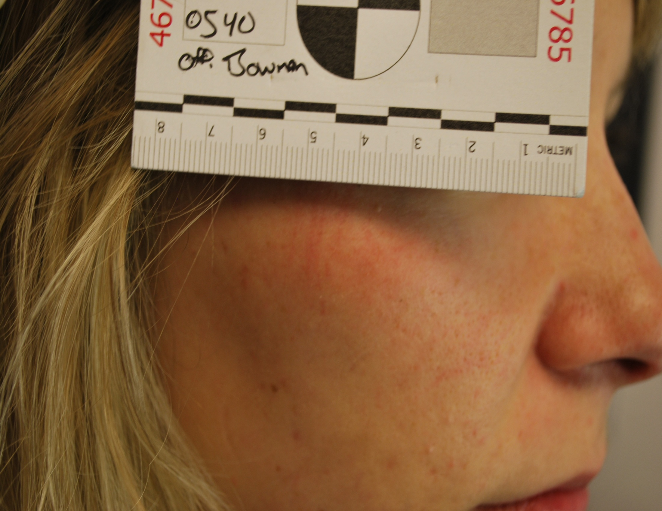
Notes:
Scratches on face

Slide 29
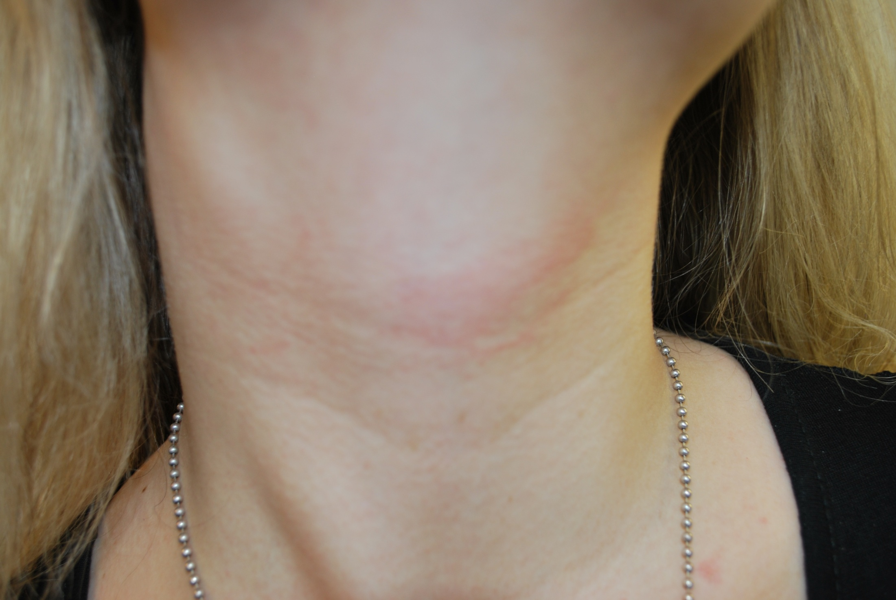

Slide 30
Symptoms associated with strangulation:
May include
  Dizziness, fainting, sore throat, cough, changes in voice, loss of voice, difficulty in or painful swallowing, difficulty breathing, hyperventilation, loss of bowel/bladder control, swelling, neck pain/swelling.
  Also note report of symptoms at time of the incident– changes in vision, blacking out, feelings of panic, etc
  (Green, 2013; Taliaferro et al., 2009; Wilbur et al., 2014)

Slide 31
Referral to health care
Working on developing and implementing training for ED at UVA
Patient has to pay for ED visit at this time
High likelihood of PTSD – high priority patients for mental health referrals
With report of multiple strangulation incidents, consider referral to neurologist for TBI assessment

Slide 32
Health Issues
Underlying brain damage may cause victim to have serious internal injuries or die days, even weeks later.
Research has shown strangulation causes permanent brain damage. “persons who have been strangled can present agitation associated with TBI (Traumatic Brain Injury), which may be misinterpreted by the responding law enforcement as hostile or uncooperative (Strack, 2000; Strack & McClane, 1999)
Notes:
New research is showing strangulation can bring on early dementia, similar to symptoms of aging boxers

Slide 33
Final Thoughts
Strangulation is a common form of IPV
It is difficult to know which victims will show obvious visible injuries, survive, or die as a result of strangulation
  Most cases produce minor to no external, visible injury, but many survivors will have internal injuries and documentable symptoms

