Slide 1
Sexualized Behaviors in Children and Teens
Offender or Victim?

Slide 2
Language is Important
Offender
Victim
Purposeful
Malicious
Dangerous
Needs be watched/
Put in jail
Innocent
Needs help
Learned behavior
Harmed by someone

Slide 3
Sexual Exploration is Normal and Healthy
Explore bodies by looking and touching (i.e. playing doctor)
Explore gender roles/behaviors (playing house)
Children involved in natural and healthy sexual play are of similar age, size and developmental status and do so voluntarily
When told to stop these behaviors typically do

Slide 4
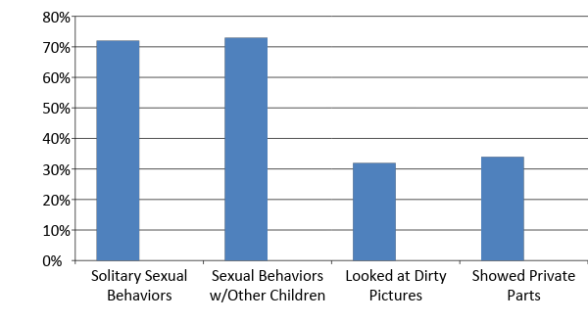
Sexual Behaviors are Very Common
A survey of 339 U.S. Child Welfare and Mental Health Professionals

Slide 5
From Healthy Exploration to Problematic
Problematic Sexual Behaviors are defined as behaviors which are initiated by a child that involve sexual body parts and are considered developmentally inappropriate and/or potentially harmful to themselves or someone else (Silovsky & Bonner, 2003).
watching porn poor supervision sexual abuse
lack of emotional connection to family or others
physical/emotional abuse and/or neglect
sexualized home environment

Slide 6
Case Example
7 year old female in foster care removed from biological mother due to domestic violence exposure. Foster mother comes to me about concerns that child is masturbating.
Lets talk about what I did, but more importantly what I learned….

Slide 7
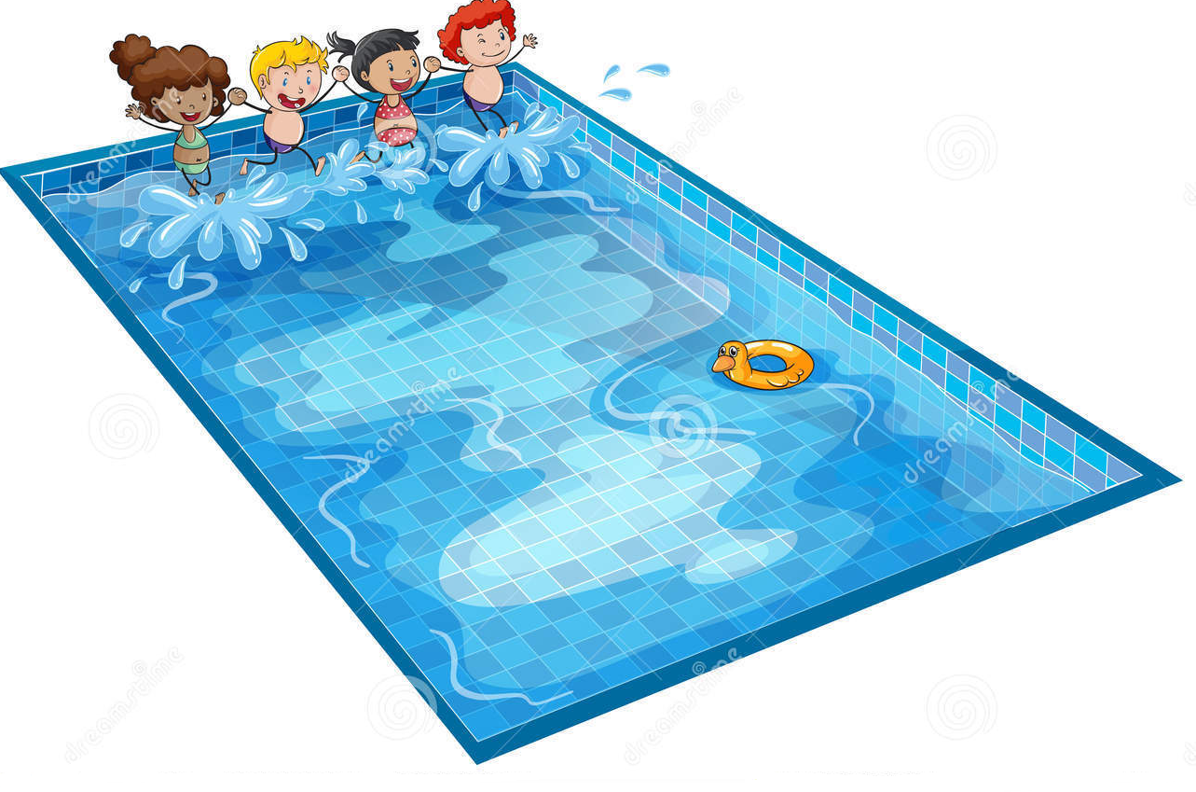
How Deep into the Pool Do You Go?

Slide 8
How We Respond To Behaviors Matters
If you choose to work with teens and/or children you must be in the pool.
Find your comfort zone
Be willing to have the conversation over and over as many times as it is needed
DO NOT punish, shame, over-react, or do any other actions that will cause the child guilt
Remain curious and compassionate and kind
DO NOT withhold affection

Slide 9
Shallow End of the Pool
Private parts – keep yours private, don’t touch other people’s private parts (bathing suit areas)
Boundaries - knock on closed doors, one person in the bathroom at a time, etc.
Clear expectations about behaviors and consequences for not following them

Slide 10
Deep End of the Pool
Proper names for body parts – Penis, Vagina, Breasts
Comfortable conversations about sex
Sex education and safe exploration of questions and concerns about sex

Slide 11
Case Example
16 year old male with history of extensive viewing of pornography and inappropriate/unwelcome touching of female classmates. 5 year old sister tells her mother that her brother attempted to touch her private part.
Lets talk about what I did, but more importantly what I learned….

Slide 12
What to Pay Attention To
Bullying or attempting to parent or control younger children in the home
Disconnected from feelings or understanding consequences of their actions
Problems engaging with others their own age/developmental level

Slide 13
Fears of Sexualized Behaviors
Child has been sexually abused themselves
Child/Adolescent will go on to abuse in the future (be a pedophile)
Talking about private parts will only make them want to offend more
They are not “fixable” and need to be institutionalized

Slide 14
The Reality of Sexualized Behaviors
Research shows that most children with sexual behavior problems have not been sexually abused themselves
Sexual abuse is not connected to future adolescent/adult offending
The majority of teens with sexualized behaviors will grow into adults with no arrests or reports for sex crimes
Children’s sexual behavior problems are very different from adults who sexually offend

Slide 15
Youth Versus Adults
Youth
Difficulty reading social cues
Socially rejected or isolated
Lack impulse control and decision-making skills
Peak of sexual development/puberty
Treatment tends to be more effective with lower rates of recidivism
Adult
Charismatic and manipulative
Gain trust of youth and caregivers easily
Patient and goal-oriented
Sexual attraction to youth and/or desire to show dominance over another person
Treatment tends to be less effective

Slide 16
Sexualized Behaviors Groups
Sexually Reactive
Extensive, Mutual Sexual Behaviors
Children Who Molest Other Children

Slide 17
Environment Matters
These children have learned behaviors, attitudes and feelings that can be unlearned
A safe environment for children with sexual behavior problems is essential for future development
Children will absorb the behaviors, values, attitudes and feelings of those around them

Slide 18
Cognitive-Behavioral Techniques
Feelings identification and expression
Social skills
Behavior management
Sex education
Parent/Caregiver training
Boundary management

Slide 19
Trauma Therapy
EMDR (Eye Movement Desensitization Reprocessing)
Internal Family Systems (parts of self)
Play Therapy (sand tray, containers, etc.)
Create a sense of safety, connect with emotions of past trauma, re-connect to healthy self

Slide 20
Questions
???

