Slide 1


Lethality Assessment Program
Curriculum
for
Law Enforcement Officers
2015
Sergeant E. Noel

Slide 2
Purpose of Training
The Purpose of this training is to explain the background and proper procedure for utilizing the Lethality Assessment Program.
The Purpose of the program is to encourage “at risk” or “high risk” domestic assault victims to utilize available services.
To decrease the number of domestic assault homicides in Chesapeake.

Slide 3
Background
Definitions
Lethality Assessment
Identifying victims who are in danger of being killed.
Lethality Assessment Program
(1) Identifying victims of domestic violence who are at the greatest risk of being killed,
(2) for the purpose of getting them out of harm’s way, if necessary, and
(3) encouraging them to go into domestic violence services.

Slide 4
Background
Why Lethality Assessment?
Why apply lethality assessment? Why first responders?
Because the PROBLEM of domestic homicide is preventive and represents OPPORTUNITIES to fill a void through:
                Statistics
                Information
                Presence

Slide 5
Background
Why Lethality Assessment?
Numbers and Opportunity
Domestic Violence-Related Homicides
Between 1999 and 2012, a total of 1,994 people in Virginia lost their lives to domestic and dating violence.5
A review of preliminary homicide data for 2012 indicates that there were at least 117 family and intimate partner homicides in 2012, representing approximately 34.0% of the 344 homicides in Virginia for the year. This represents a 12.7% decrease in the number of identified family and intimate partner homicides from 2011 to 2012. The most common factors that precipitated these domestic violence homicides included the following:
A verbal dispute of an unknown topic (19%)
Child abuse or neglect (16%)
The ending of an intimate partner relationship (15%)
Financial issues (13%)
Substance or alcohol use (12%)

Slide 6
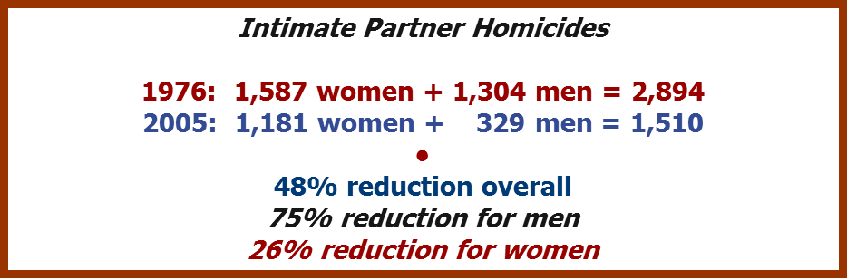
Background
Why Lethality Assessment?
Numbers and Opportunity
1500 DV fatalities a year in the U.S.
For every 1 DV homicide, 8-9 near homicides
Police previously on the scene in 50% of DV homicides.
Only 4% of DV homicide victims had ever availed themselves of DV services.
Re-assault dropped by 60% when victims went into shelter; (Newbury, MA)

Slide 7
What does the Data Tell Us?
That domestic violence programs PROTECT victims….
High Risk victims are not utilizing those services!

Slide 8

Background
Why Lethality Assessment?
Information and Opportunity
Because the INFORMATON is already there
Through research-based work of Dr. Jacquelyn C. Campbell.
Danger Assessment (www.dangerassessment.org)

Slide 9
Why Lethality Assessment?
Presence and Opportunity
Causes greater awareness of danger and lethality.
Causes greater consideration of proactive interventions.
Educates system participants
Allows victims to see through “different lens”.
Enhances 3 C’s:
Coordination
Communication
Cooperation

Slide 10
Background
Development
Began October 2003
Goal: create a user-friendly instrument and a proactive protocol.
Purpose: to enable first responders to identify domestic violence victims who are at greatest risk of being killed.

Slide 11
Background
Development
(continued)
Established Lethality Assessment Committee in 2003, (Police Officers included)
Field tested in 2004 in 3 jurisdictions to determine if LAP was user-friendly.
84% of officers and 95% of advocates said LAP was “very easy” to “fairly easy” to do.
Maryland Implemented LAP October 2005.

Slide 12
Background
Lethality Screen: 11-questions, user-friendly, research-based.
Protocol: Officer making phone call to and encouraging victim to speak with hotline.

Slide 13
More Background
Developed from the start with officers involved
Been doing this for years..
  now formalized and all on same page
  now doing something further
  now including support (HER Shelter)

Slide 14
Once involved in Support
More likely to cooperate with prosecution
More likely to continue with support
Less likely to stay in abusive relationship
Less likely to be a victim of domestic homicide
Less repeat calls for service for PD

Slide 15
Why is this important to Me?
Save lives and improve quality of life for the community at large.
Support the Departments Crime Reduction Plan.
Reduction of Homicides in the City.
Protection from Civil Liability.

Slide 16
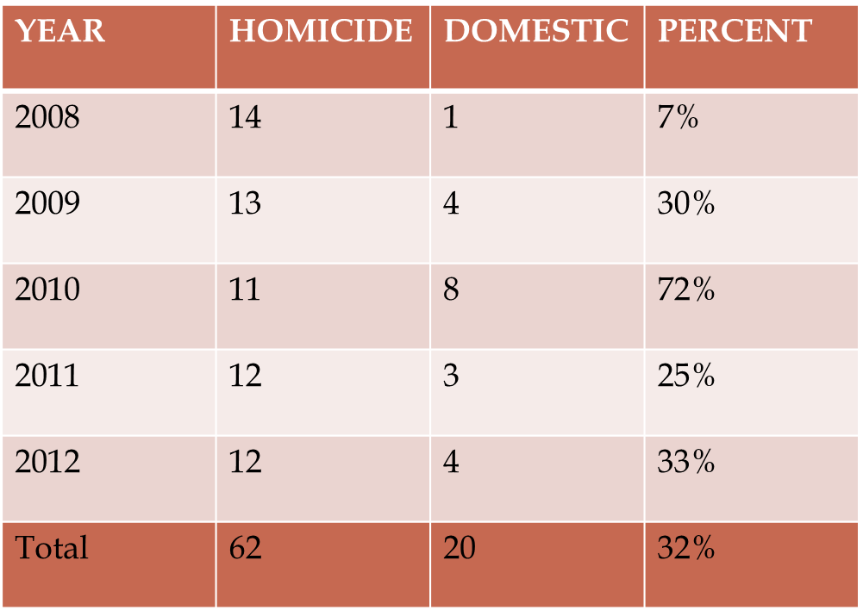
Homicides Numbers
Last 5 Years
Chesapeake

Slide 17
How the LAP Works
Lethality Screen for First Responders

Slide 18
How the LAP Works
Protocol for First Responders
Key features:
Making phone call. Not the norm for officer or hotline worker, but you are a TEAM. Respect each other’s task.
Encouraging the victim. Be supportive in your words and actions.
Cooperating with hotline worker. Convincing the victim to get on the phone and then for the hotline worker to convince him/her to go into services. The victim will “know” if you’re working together.

Slide 19
How the LAP Works
When to Initiate a Lethality Screen
Only in Cases of Intimate Relationships…
FACTORS TO CONSIDER:
When there’s been an assault or other act of domestic violence
When you believe the victim faces danger once you leave
When the home or parties are repeats
The suspect seems overly jealous or controlling
The suspect has threatened to kill the victim or their kids

Slide 20
How the LAP Works
When to Initiate a Lethality Screen
Only in Cases of Intimate Relationships…
FACTORS TO CONSIDER:
The suspect has caused injury to the victim
The victim fears retaliation from the suspect due to police involvement
The victim believes the suspect might try to kill him/her
There is drug/alcohol abuse in the household
When your gut tells you the situation is dangerous

Slide 21
How the LAP Works
Initiating the Lethality Screen
Advise victim that you would like to ask him/her some questions to get a better idea of the situation.
Ask all the questions in order.
Approach the Lethality Screen simply and positively with the victim.

Slide 22
How the LAP Works
Screen-ins and Cut-offs
Yes to Q. #1, 2, or 3 =Protocol Referral (PR).
No to above, but Yes to 4 or more of Q. #4-11 =PR.
No to all, or no more than 3 of Q. #4-11, may still trigger PR if officer believes it appropriate.
Officer may trigger PR whenever he/she feels it is necessary.
If PR not triggered, officer may ask additional question during the screen to help decide whether to trigger PR.

Slide 23
How the LAP Works
Non-Protocol Referral
Advise victim DV situations are dangerous.
Advise victim to look for signs of danger.
Refer victim to provider.
Give victim contact information.
Prepare report.

Slide 24
How the LAP Works
Protocol Referral
Victim Agrees to Speak on Phone
Advise victims they are in danger, that people in their situation have been killed.
Tell victim you will call hotline to get information to help her and you would like for them to consider speaking to hotline.
Call hotline.
Provide basic information to hotline.
Put victim on phone and stand-by.
When victim finishes, conclude call by speaking with hotline

Slide 25
How the LAP Works
Protocol Referral
Victim Declines to Speak on Phone
Advise victim they are in danger, that people in their situation have been killed.
Tell victim you will call hotline to get information to help, and you would like for her to consider speaking to hotline.
Even when victim declines, you will still call hotline.
Provide basic information to hotline.
Interrupt call and encourage victim to speak.
If victim still declines, obtain safety planning information.
Request a safe phone number from victim and give to hotline.
Conclude call.
Advise victim of safety planning points provided by hotline.

Slide 26
How the LAP Works
Stats in Maryland
CY 2006-2010
54% assessed at High Danger (HD).
59% of HD victims spoke on phone to hotline.
33% of HD victims who spoke went into services.
1 screen administered for every 450 people.*
0.3 screens/day/agency.

Slide 27
Issues and Concerns
Phone precautions:
-- Use victim’s landline phone.
-- Delete hotline number as last-call-made.
-- Don’t use victim’s cell phone.
-- No phone? Consider officer’s cell, supervisory phone, or neighbor’s.
-- GET IT DONE!

Slide 28
Issues and Concerns
(continued)
When officer can’t administer Screen?
Find a way!
3. What is officer to do while victim speaks with hotline?
Stand-by. Hotline worker will advise if
officer is still needed. Final decision between
officer and victim.
4. How should an officer use a Screen in mutual battery cases?
Highly unlikely that both parties are dangerous and
controlling. Be wary of administering Screens to
both parties. Screen the victim in the relationship.

Slide 29
Where the paperwork goes
Make sure the Lethality Assessment sheet is completed thoroughly.
Attach the Lethality Assessment sheet to your ARS. (whether or not a referral was done)
Forward the originals to CIS (whether or not a referral was done).
Document all of the information in your ARS narrative.

Slide 30
Summary
The LAP is fast and can save lives.
You can initiate the process anytime you feel it is necessary.
You must initiate the process if the criteria are met.
Be positive about the program in front of the victim.

Slide 31
LAP Results 2013-2014
Homicides in the city of Chesapeake Domestic Related.
2013 – 8 Homicides, 2 were domestic related. None of the homicides were intimate party related.
2014- 9 Homicides, 1 was intimate party relationship. No previous police contact with that case.

Slide 32
LAP Results 2013-2014
The statistics show that there has been a reduction in the intimate party relationship homicides in the city of Chesapeake since the Implementation of this program.

Slide 33
CLETA Roll Call Training
This Concludes this Training Module

