Slide 1

Trafficking in Persons
The recruitment, harboring, transportation, provision, or obtaining of a person for labor or services, through the use of force, fraud, or coercion for the purpose of subjection to involuntary servitude, peonage, debt bondage, or slavery.
Sex trafficking: a commercial sex act is induced by force, fraud, or coercion, or in which the person induced to perform such act has not attained 18 years of age.
Notes:
Instructor Notes:
In 2000, the federal government passed the Trafficking Victims Protection Act which defined human trafficking, created new crimes, created new remedies for victims, and recognized that victims are foreign nationals and US citizens and that the crime occurs within and across borders.
Under the TVPA, human trafficking (referred to as Trafficking in Persons) was defined (definition above)
Note that this is NOT the criminal statute/definition, but the general definition in the TVPA (criminal statutes are 1589 and 1591)
Note the three key word highlighted in red as central to defining human trafficking
Go to next slide to breakdown the definition of human trafficking
The definition of “severe forms of trafficking in persons” is not a criminal statute. There are human trafficking criminal provisions
that correlate to this definition. This definition is used by the U.S. Department of Homeland Security when assessing whether a
victim meets the defined criteria in order to be granted an immigration remedy (e.g., continued presence or a T-Visa).
Cite: Trafficking Victims Protection Act of 2000, Sec. 103(8)(A-B), Pub. L. No. 106-386 (2000).
1

Slide 2
Domestic Minor Sex Trafficking:
America’s Prostituted Youth

Slide 3
DMST Defined
Federal TVPA:
  Any youth under the age of 18 involved in a commercial sex act
  Anything of value given to or received by any person (money, food, shelter)
  Survivors of DMST should not be held responsible for crimes committed during the course of their exploitation
Notes:
DISCLAIMER!!!!! --- 1) Not minimizing foreign nationals 2) Acknowledge LGTB youth and boys are victims too, but primary population is girls….”she”

Slide 4
Force, Fraud, Coercion
Force:
  Physical restraint, bodily harm (physical or sexual), or confinement
Fraud:
  Deceitful employment offers or work conditions, false promises, or withholding wages
Coercion:
  Threats of serious harm, bodily harm against any person, abuse of legal process, withholding legal documents, creating a climate of fear
Notes:
Instructor Notes:
Ask students to give examples of each
For coercion, highlight the abuse of legal process such as threats of deportation or calling immigration/police to maintain control of victims
For coercion, the federal government defines “serious harm” as physical or nonphysical harm that is sufficiently serious under all the surrounding circumstances to compel a reasonable person of similar background to perform commercial sex or labor/services (e.g. reputation, financial, psychological)
Note that unlike older slavery laws, human trafficking laws do not depend solely on bodily harm, but that threats (coercion) or fraud are sufficient
Note that not all three means need to be proved to be human trafficking, but a single means can be sufficient
4

Slide 5
TOTAL CASES &VICTIMS
From FY 2011 to the present, the United States Attorney’s Office for the Eastern District of Virginia (Alexandria Division) has prosecuted 21 total cases against 38 defendants engaged in human trafficking and closely related conduct throughout northern Virginia. These cases involved at least 37 juvenile victims of sex trafficking, over 260 adult victims of prostitution and sexual exploitation, and 2 adult victims of forced labor.

Slide 6
GANG-CONTROLLED SEX TRAFFICKINGU:
8 of the cases involved gang-controlled sex trafficking with 12 total defendants, at least 27 confirmed juvenile victims and 10 adult victims, and sentences imposed from life imprisonment to 50, 40, and 10-25 years in prison.
INTERSTATE PROSTITUTIONU:
10 of the cases involved sex trafficking or interstate prostitution unconnected to gangs, with at least 10 confirmed juvenile victims and over 250 adult victims of prostitution or sexual exploitation.

Slide 7
TRAFFICKING-RELATED CASES:
8 of the cases involved trafficking “related” prosecutions where sex trafficking was not directly charged, but the conduct had a demonstrated connection to commercial sex involving adults.
FORCED LABOR:
1 case involved the forced labor of two domestic servants
GEOGRAPHIC DISTRIBUTION:
The cases listed above involved conduct that occurred throughout northern Virginia, including in Fairfax, Prince William, and Arlington County and Alexandria and Falls Church, Va., as well as in the District of Columbia, Maryland, New York, New Jersey, Delaware, Pennsylvania, Ohio, North Carolina, South Carolina, Georgia, Tennessee, and Florida.

Slide 8
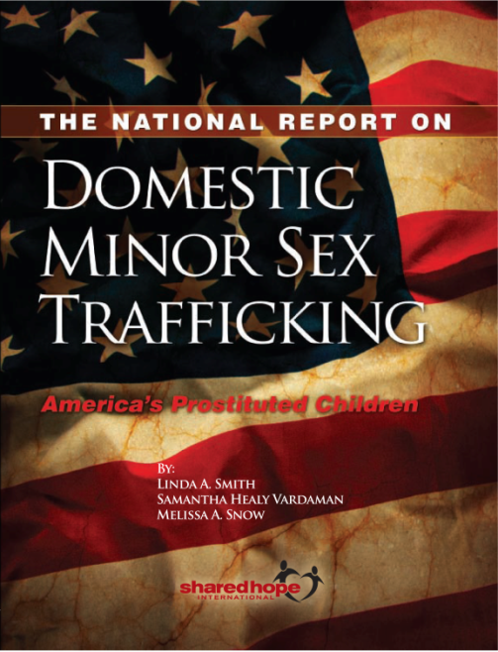
The National Report on
Domestic Minor Sex Trafficking
Shared Hope International received a grant from the Department of Justice to assess Domestic Minor Sex Trafficking in ten areas in the United States, which culminated in the National Report, released in July 2009.
The findings:
At least 100,000 children are used in prostitution every year in the United States (NCMEC)
The average age of entry into prostitution is 12-14 years old
Misidentification is the primary barrier to services and intervention for DMST victims
American children are easy targets because of their age – pre-teen and adolescent girls are especially susceptible to the deception of traffickers

Slide 9
Manifestations of DMST
Pimp-controlled DMST
Familial Pimping
Survival sex
Gang Controlled

Slide 10
Who are the victims of domestic minor sex trafficking?
Youth of any ethnicity, race, or religion
Youth of any socio-economic class
Female, male, and transgender youth
Youth of all ages, including teenagers
Vulnerable youth
Notes:
10

Slide 11
Why is it hard to identify domestic minor sex trafficking victims?
Physically and/or psychologically controlled by pimps
Trained by pimps to tell lies and false stories
Victims’ distrust of service providers & law enforcement
Not self-identifying as a victim (minimizing abuse)
Frequently moved from place to place
Technology can help disguise the real age of the victim
Easy to obtain fake I.D.s
Notes:
11

Slide 12
Who are the Traffickers?
Pimp = Trafficker
Can be a boyfriend, father, mother, brother, uncle, a coach, a teacher or anyone exerting control over a minor, even a peer or group of peers (ie: gang)
Men and women of varying ages
Any ethnicity or race
Anyone who benefits from the commercial sexual exploitation of a minor or facilitates the commercial sexual exploitation of a minor

Slide 13
Pimp Control: Recruitment
Calculated targeting and recruitment
  Online or in-person
Friendly conversation, assess home/life situation
Determine vulnerabilities and dreams (investment of time ensures a strong foundation of trust) -- predators
Sara’s story

Slide 14
Quotes
“Any player can tell when a girl has the look of desperation that you know she needs attention or love. It’s something you start to have a sixth sense about.”
“It’s impossible to protect all girls from guys like I was because that’s what we do. We eat, drink and sleep thinking of ways to trick young girls into doing what we want them to do.”
From Victims to Victimizers: Interviews with 25 Ex-Pimps in Chicago

Slide 15
Pimp Control: Grooming
Fulfilled promises = trust, love, devotion
Isolation & Breakdown of safety net (inability to walk away)
Sexual relationship, demands – punishes refusal, hesitation
Gifts, favors, attention

Slide 16
Pimp Control
“You'll start to dress her, think for her, own her. If you and your victim are sexually active, slow it down. After sex, take her shopping for one item. Hair and/or nails is fine. She'll develop a feeling of accomplishment. The shopping after a month will be replaced with cash. The love making turns into raw sex. She'll start to crave the intimacy and be willing to get back into your good graces. After you have broken her spirit, she has no sense of self value. Now pimp, put a price tag on the item you have manufactured.”
The Pimp Game; An Instructional Manual (Royal, 1998)

Slide 17
Pimp Control: Turning Out
Introduction to The Game – “you’re already doing this…now you can get paid”
Breakdown of self-esteem
Continuing use of physical and psychological torture w/ affection = Trauma Bond (defensive mechanism)
Seasoning (rape, sodomy, beatings, starvation, drug use, breakdown of resistance)
New name

Slide 18
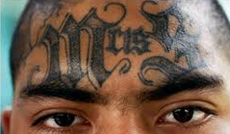
Gang Trafficking vs. Pimp Control
Gangs are territorial
Girls are pimped in their own neighborhoods
or region
Recruitment tactics
Control: drugs/alcohol
Pimped by the “family” –
not just one guy
Fear of retaliation keeps everyone in check (girls, buyers, neighbors)

Slide 19
Adult vs. Child Trauma
Trauma in Adults –
changes their relationship with themselves and the world.
Developmental trauma in Children – changes the child’s character and personality.
-Sophia Deborah Erez

Slide 20
Impact of DMST Trauma
Constant state of fear, threat, hypervigilance
Quantifying trauma:
5 rapes x 5 days a week for 1 year
=1,300 rapes per year
Beatings and torture by the buyers/rapists
Beatings and sexual abuse by the trafficker/pimp

Slide 21
Adolescent brain
Functions that develop from puberty to adulthood:
  Self control
  Judgment
  Emotional control
  Organization
  Problem solving
So…what part of the brain takes control?
http://www.edinformatics.com/news/teenage_brains.htm
Notes:
As noted two slides ago, the thinking response can be trained to dominate the unthinking response; however, the adolescent brain in not fully developed in the executive (thinking) function. The non-thinking (emotional, reactive) response is in control.

Slide 22
Understanding Complex Trauma
Chronic traumatic experiences → Biological & Neurological processes → Psychological & Physical state responds
Behaviors of DMST victims are symptoms
Severe/Chronic Abuse in DMST = Developmental and Shock Trauma

Slide 23
What you see (psychological):
Panic attacks
Agoraphobia, Claustrophobia, Social phobia
Anorexia, Bulimia
Bipolar
Paranoid, avoidant, dependent, hopelessness
OCD
Insomnia, hypersomnia
Self mutilation
Substance abuse
Bed wetting, flashbacks, nightmares

Slide 24
What you see (physical):
Sexually transmitted diseases
Burns, scars and other signs of chronic abuse
Broken or missing teeth
Tattoos
Damage to sexual organs

Slide 25
Initial Barriers to Healing/Restoration
Victims are “in love” with their abusers (trauma bonds)
Loyalty: He’s not a pimp, he’s my boyfriend
Not “wanting” help
Victims blame themselves, believe it was a choice
Returning to abuser/returning to “the life”

Slide 26
(Cont..)
Rebelling against rules and structure
Lack of trust leads to lying, manipulation
Sexual confusion: Am I gay? Straight? What’s appropriate sexual behavior?
Glamorizing the exploitation

