Slide 1

OVERCOMING SUBSTANCE ABUSE TO BUILD A BETTER PARENT
Problems, Trends and Treatment

Slide 2

CHILDREN OF SUBSTANCE ABUSING PARENTS
More likely to find themselves in foster care as a result of maltreatment than other children
More likely to stay in foster care longer than children of non-abusing parents.
U.S. Department of Health and Human Services, 1999. HHS. Quoted in Parental Substance use and the Child Welfare System, Child Welfare Information Gateway, Bulletin for Professionals, January 2009.

Slide 3

Trouble, right here in River City…
Apparent Meth Lab uncovered on Meander Drive (7/10/12 – Culpeper)
Woman Dealt Bath Salts from Fifth Street Video Store (4/26/12 – Charlottesville)
Woman Charged With Distributing Marijuana (2/7/13 – Culpeper)

Slide 4
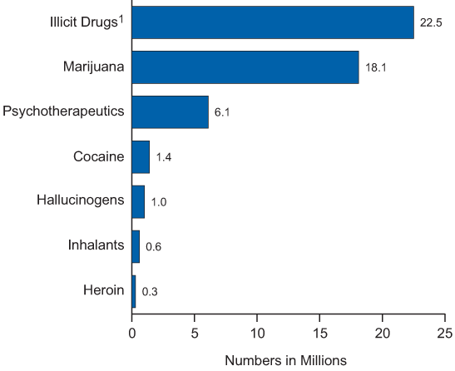
Prevalence of Use of Illicit Drugs
Past month drug use among persons 12 or older in 2011.
SAMHSA
Results from the 2011 National Survey on Drug Use and Health:
Summary of National Findings
1 Illicit Drugs include marijuana/hashish, cocaine (including crack), heroin, hallucinogens, inhalants, or prescriptiontype
psychotherapeutics used nonmedically.
Notes:
In its National Survey on Drug Use and Health, The Substance Abuse and Mental Health Services Administration tracks data concerning drug use and issues an annual report, which includes survey snapshots such as this one, which tells us that in the month surveyed 22.5 million of those surveyed over the age of 12 admitted to illicit drug use. While these reports are less useful for making real estimates of use because of self-reporting, they are very useful in looking at trends in use. One of the more interesting trends noted was an increase in heroin use among young adults.

Slide 5
Children Affected By Substance Abuse in the U.S.
U.S. Department of Health and Human Services, SAMHSA, OAS. (2009).

Slide 6
Now Trending
Spice (synthetic marijuana)
Description
Dangers
Herbal mixtures with other additives that produce an effect similar to that of marijuana
Usually smoked or drunk as a tea
These synthetics do not usually show up on a routine drug screen
Acts on same brain receptors as THC, but may have a stronger effect
There have been reports of rapid heart rate, vomiting, agitation, confusion, hallucinations, raised blood pressure and rarely, heart attack

Slide 7
Now Trending
Salvia
Description
Dangers
Herb common in Mexico, Central and South America
Produces an intense, but short-lived hallucinogenic experience
Usually taken orally by eating or in a tea. Can also be smoked or vaporized and inhaled
Little is known about the long-term effects of the substance
In one study lab rats showed learning and memory impairment
Great concern about users driving under the influence of this substance

Slide 8
Now Trending
Bath Salts (synthetic cathinones)
Description
Dangers
Synthetic drug that acts as an amphetamine-like stimulant
May be taken orally, inhaled or injected
Effect on the user may mimic methamphetamine or MDMA (ecstasy)
Cardiac symptoms and psychiatric symptoms like paranoia, hallucinations and panic attacks
“Excited delirium” – dehydration, breakdown of skeletal muscle tissue, kidney failure
Highly addictive
Notes:
There is a great deal of concern about bath salts as it considered VERY addictive. While the federal government has moved to control a number of synthetic stimulants used in the manufacture of bath salts, it is very difficult to keep up with new methods of production.
Cathinones are Schedule I drugs in the U.S., meaning (1) they are highly addictive, (2) there is no accepted medical use for the drug, (3) lacks safety for use under medical supervision. It is illegal to manufacture, distribute or posess Schedule I drugs.

Slide 9

How did I get here?

Slide 10
Substance-Exposed Infants
Health care providers required to report per Virginia Code 63.2-1509
  Toxicology studies made within six (6) weeks of birth
  Withdrawal symptoms noted within six (6) weeks of birth
  Child is diagnosed at any time with a condition which, to a reasonable degree of medical certainty, is attributable to in utero exposure to a controlled substance or to alcohol

Slide 11
Criminal Involvement
Manufacture or distribution followed by arrest
Illicit drug use followed by arrest
Crimes of violence fueled by substance abuse/misuse
Property crimes to support drug use resulting in arrest
Other court involvement

Slide 12
Abuse and Neglect Reports
Reports directly referencing drug use, distribution or manufacture
Reports of abuse or neglect that are an indirect result of substance abuse or misuse
Absence of parent due to substance abuse/misuse (e.g., in treatment, in jail, etc.)

Slide 13
Effects of Substance Abuse on Children in Household
Physical injuries
Physical neglect
Sexual abuse
Emotional maltreatment
Educational neglect

Slide 14
Effects of Parental Substance Abuse
Prenatal Exposure
  Low birth weight
  Intellectual functioning
  Physical abnormalities
  Attachment disorder
  Emotional disorders
Use During Childhood
  Disruption of the bonding process
  Lack of structure and supervision
  Lack of positive role models and stigmatization in the community

Slide 15
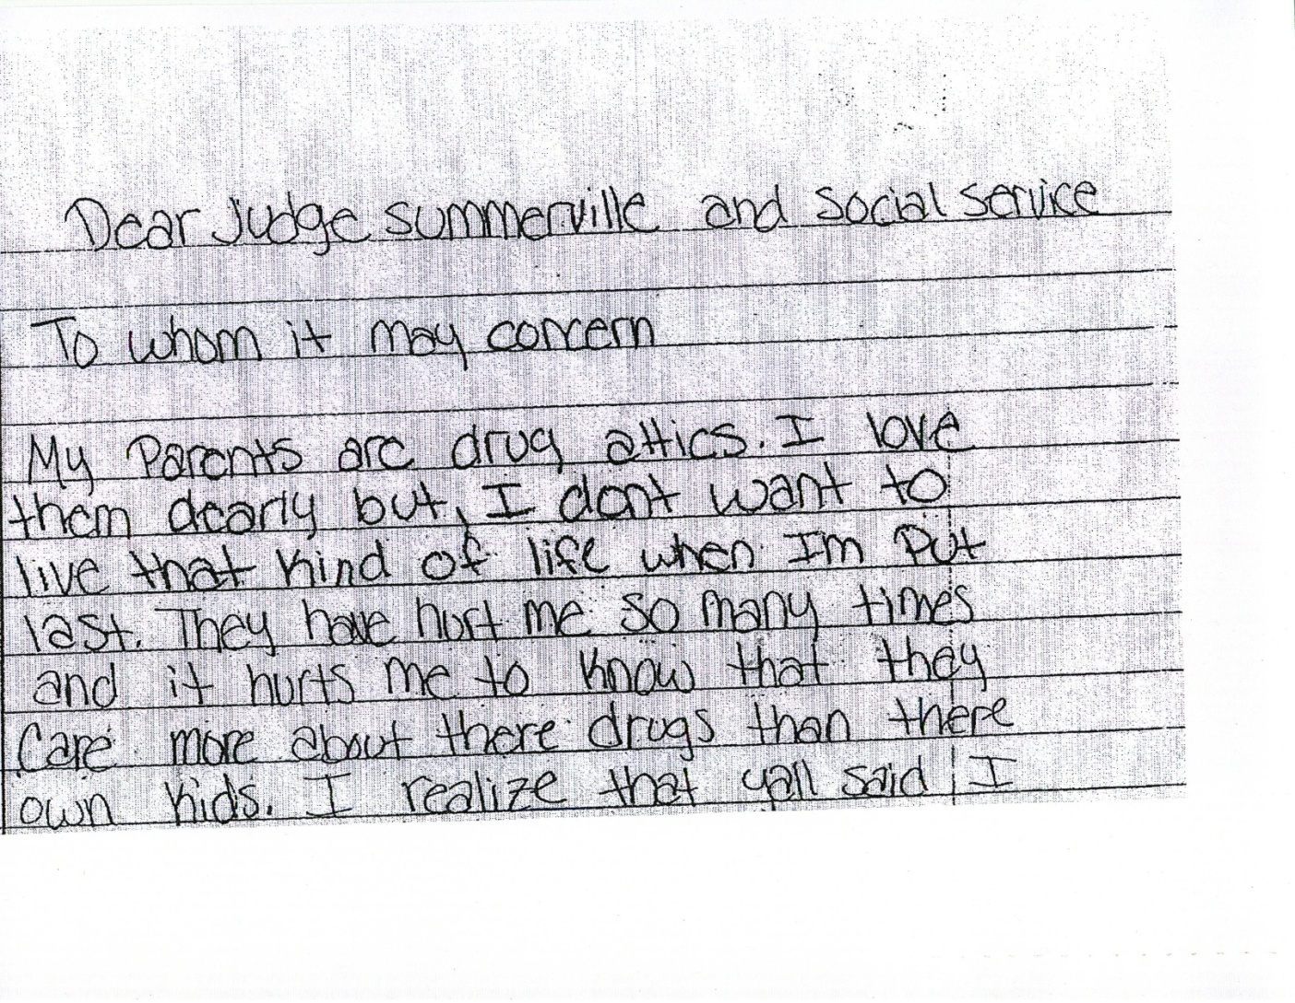
Letter
From the Mouths of Babes

Slide 16
Concurrent Problems
    Unemployment or underemployment
    Homelessness or instability in housing
    Domestic violence
    Involvement with the criminal justice system
    Mental illness

Slide 17
Substance Dependence or Abuse and Mental Illness Among Adults
Substance Dependence or Abuse
Mental Illness
8 Mil
10.9 Mil
37.6 Mil
2011 National Survey on drug use and Health: Mental Health Findings. U.S. Department of Health and Human Services Administration, Center for Behavior, Health, Statistics and Quality. www.samhsa.gov

Slide 18
How do I get back home?

Slide 19
Treatment Options
Cognitive-Behavioral Therapy
Contingency Management Interventions
Matrix Model
12-Step Facilitation Therapy
And many, many other forms of treatment, some proven and some not.

Slide 20
Successful Treatment
Treatments backed by scientific evidence
Tailored to specific needs of each client
Program adaptability to meet changing needs of clients
Sufficient duration of treatment
Post-treatment plan (e.g., 12-step programs)
Collaborative approach to treatment

Slide 21
Service Fragmentation
Substance Abuse Treatment
Mental Health Treatment
Family Therapy
Housing and Transport Assistance

Slide 22
What Works Best?
Fully integrated services including:
  Drug treatment
  In-home services to families
  Education and/or employment related services
  Effective aftercare and monitoring
  Continued counseling and/or medication management for users with mental health issues
  Parenting support groups
  Help finding housing and transportation

Slide 23
Need for Speed vs. Effective Intervention
Timely resolutions that result in permanency for children in foster care
Reasonable efforts that effectively prepare parents for return home

Slide 24


Looking for a happy ending…

Slide 25

Substance Abuse Treatment at Rappahannock-Rapidan Community Services (RRCS)
Programs That Matter – People Who Care

Slide 26

Access To Services
825-5656 – Culpeper 672-2718 – Orange 347-7629 – Fauquier
Consumers with substance abuse needs fast-tracked:
  Call appropriate clinic
  Special intake is scheduled for outpatient services
  $35 flat fee
  No proof of income required

Slide 27
Access to Services (cont.)
Inpatient Substance Abuse Needed???
  May be determined at a flat fee intake - $35
  May be determined at an Emergency Intake - $75+
  Prescreens available at the jail for a fee of $10, which MUST be paid in advance

Slide 28
Outpatient vs. Inpatient???
Least Restrictive Environment is Rule of Thumb
Collaboration
Type of drug/s used
Lengthy of use
Past experience with treatment or sobriety
Existing support system
Motivation to change
Collaboration with the referring agency is very helpful at every step from intake to discharge!
Great to have information at the time of intake for accurate recommendation

Slide 29
Outpatient SA Services
Women’s Alternatives
Co-Ed Substance Abuse Group
Other Counseling – mental health groups and one-on-one counseling

Slide 30
Women’s Alternatives
Meets Tuesdays & Thursdays from 9am – 12pm
Minimum 30 sessions at $10 per session
Substance abuse education
Life skills & women’s issues
Relapse prevention skills
Auricular acupuncture
12 Step meeting attendance

Slide 31
Co-Ed Substance Abuse Group
PHASE ONE
One time per week for total of six sessions
$15 per session
Education about substance abuse and dependence
Motivation for change
Early recovery/relapse prevention skills

Slide 32
Co-Ed Substance Abuse Group (cont.)
PHASE TWO
Two times per week for total of 20 sessions
$15 per sessions
For men and women who already have a basic understanding of the disease of addiction, through completion of Phase One, an inpatient program or some other outpatient program
Includes auricular acupuncture, relapse prevention, increasing self-awareness and coping skills, mindfulness practice and attendance at AA/NA (at least once per week)

Slide 33
Co-Ed Substance Abuse Group (cont.)
PHASE THREE
Once per week for a total of 10 sessions
$15 per session
Relapse prevention group for those who have completed Phases One and Two or the equivalent
Requires attendance at a minimum of two AA/NA meetings per week

Slide 34
Co-Ed Substance Abuse Group (cont.)
Most clients are referred to Phases One, Two and Three.
Only clients needing only SA education are referred just to Phase One

Slide 35
Co-Ed Substance Abuse Group (cont.)
Completion of all three phases takes about nine (9) months
  Certain individuals may benefit from longer treatment and/or individual therapy
Evidence Based Practices Are Used
  Motivational Enhancement Therapy
  Motivational Interviewing
  Matrix Model
  Cognitive Behavioral Therapy

Slide 36
“Acu-Detox”
NADA Auricular Acupuncture
A unique part of the SA services in Culpeper both for outpatient programs and the Boxwood Recovery Center, designed to assist client with:
  Detoxing from alcohol & other drugs (including nicotine)
  Relief from withdrawal symptoms and cravings
  Reducing anxiety and depression
  Improved sleep

Slide 37
“Acu-Detox” (cont.)
Many clients find the treatment relaxing and report that it contributes to their overall sense of well-being.
Method:
  At five designated ear points in each ear, NADA-trained clinicians apply fine gauge, sterilized, one-time use stainless steel acupuncture needles
  The needles remain in place 30-45 mins.
  Appropriate for adults and teens

Slide 38
“Acu-Detox” (cont.)
In addition to being provided in Women’s Alternatives and the Co-Ed Group, there is a FREE Acu-Detox group open to all RRCS clients held every Tuesday from 4:30pm – 5:30 p.m.

Slide 39
Inpatient SA Treatment
Boxwood Recovery Center
  28-day program for $1,610
  Must be clean for 7-10 days in order to enter Boxwood
  Closure of New Hope detox facility creates a challenge!
  Good News: Boxwood to open 6-bed detox unit this summer, with admissions available 7 days per week
Stay tuned for more details…

Slide 40
Funding Sources
Availablity of SARPOS funds for qualifying clients
Best to have clients pay portion of fee when possible
For OP group treatment, fee must be paid each time
Sliding scale applies to individual therapy or medication appointments
We like cost-sharing with other stakeholders and welcome partnering on behalf of clients!

Slide 41

REMEMBER…
Substance dependence is a chronic disease – once you have it, you ALWAYS need treatment. This is one of the hardest lessons to learn for addicts and their loved ones.

Slide 42
Resources
SAMSA (Substance Abuse & Mental Health Services Administration www.samhsa.gov
RRCSB
www.rrcsb.org

Slide 43
Boxwood Recovery Center
15511 Guinn Lane 540-547-2760
Culpeper, VA 22701

Slide 44
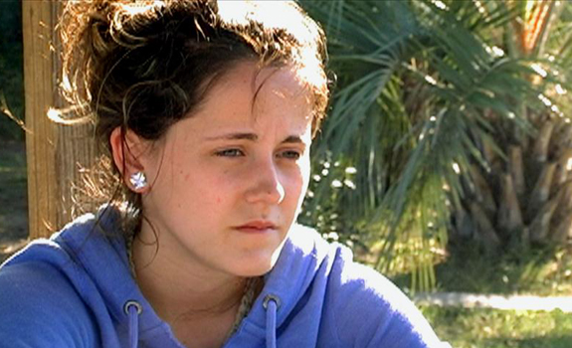
Case Study – Mary Smith
Mary is a 20-year-old female addicted to opiates, marijuana and alcohol. She has a prior history of Bipolar Disorder, 296.80.
Mary lost temporary custody of her 8-month-old daughter due to chemical dependence and mental health problems

Slide 45
Case Study (cont.)
Mary was referred to Boxwood by the local Community Services Board, her Probation Officer and the Department of Social Services
Her goal for substance abuse treatment was to learn how to stay clean to regain custody of her daughter

Slide 46
Case Study (cont.)
While in treatment, her Social Worker called on a weekly basis to receive information about her progress. The Clinician at Boxwood reported some of the following therapeutic interventions.

Slide 47
Case Study (cont.)
Mary was assisted in implementing a balanced and structured daily routine. She attended AA/NA meetings every evening and learned about the 12-step recovery program.
Mary learned to identify people, places and things to be avoided.
She learned about the specific behaviors, attitudes and feelings that led up to the last relapse.

Slide 48
Case Study (cont.)
Mary learned and implemented coping strategies to manage urges to lapse back into chemical use.
Mary identified the negative consequences of drug and alcohol abuse.
Mary verbalized principles to live by that will support sobriety
Mary identified and replaced destructive self-talk with positive, strength building self-talk.

Slide 49
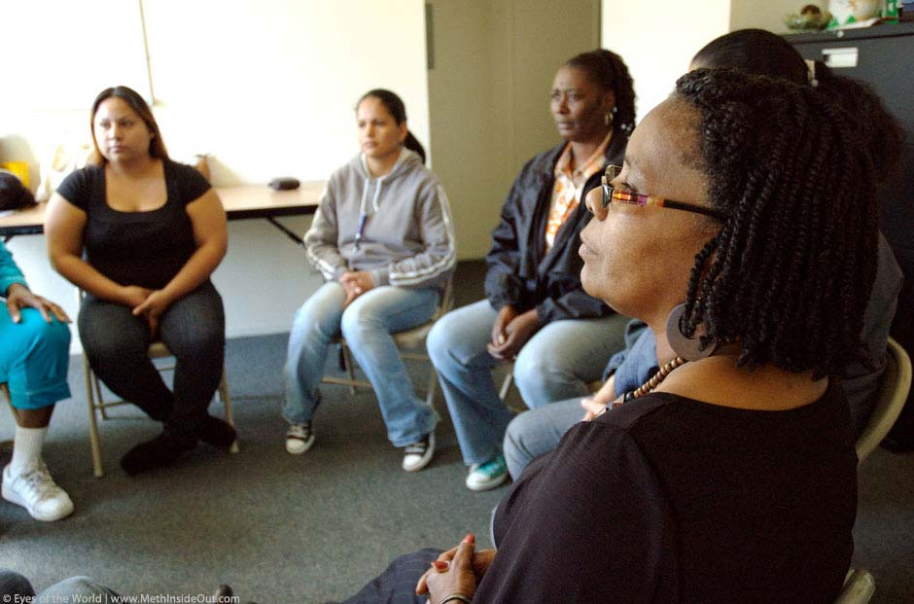
Case Study (cont.)
During group therapy, Mary learned to implement personal skills to manage common day-to-day problems (e.g., work, social, family demands) using behavioral and cognitive restructuring techniques to build social and communication skills.

Slide 50
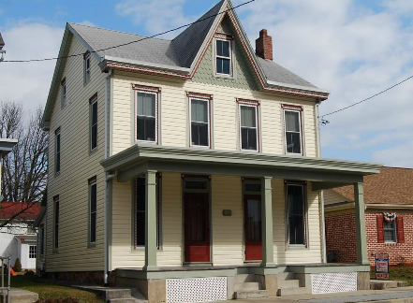
Case Study (cont.)
Mary developed a written after-care plan that supported the maintenance of long-term sobriety.
She successfully complete the 28-day substance treatment program at Boxwood and was accepted into a supportive home for women learning to live sober and productive lives called the Grace House.

Slide 51
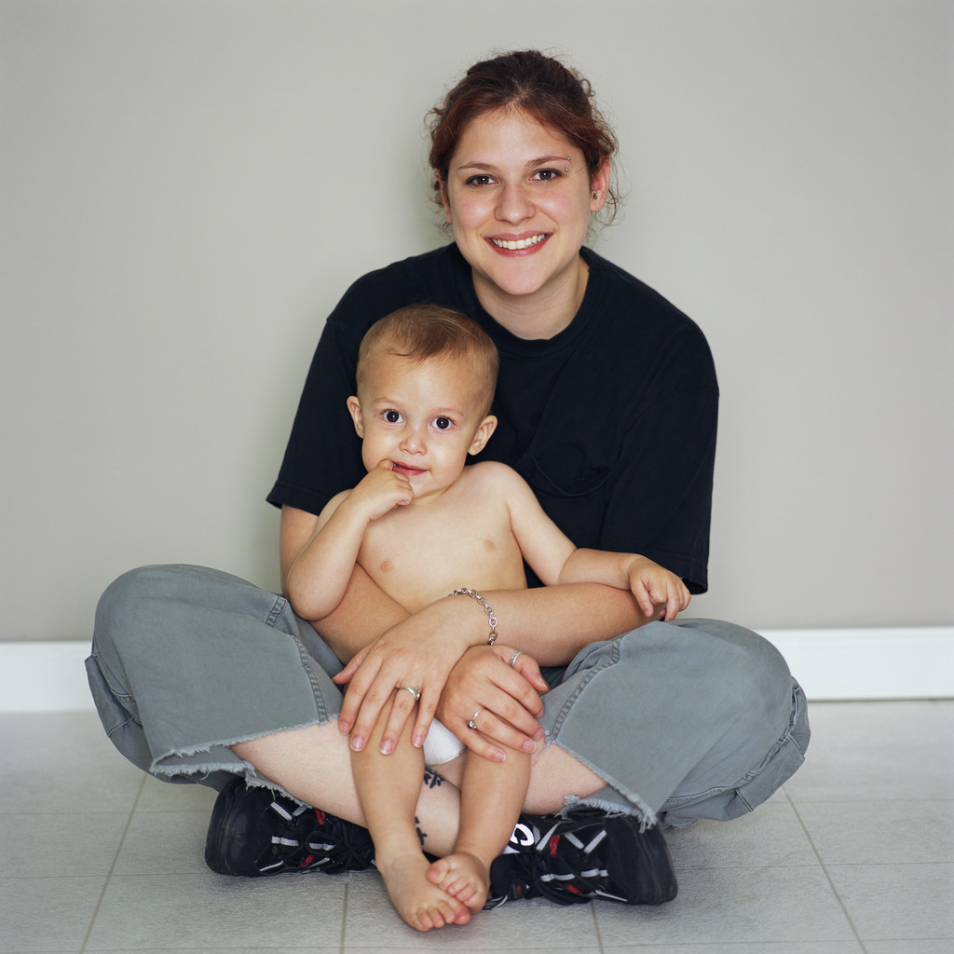
Case Study (cont.)
Mary is able to receive visitation with her child once a week at the Grace House. As of April 5, 2013, she has been clean for 64 days. She is reaching her goal of staying clean and working towards regaining custody of her daughter.

