Slide 1

IN AN AGE OF WRECKS, DRUGS
AND SHOCKING SOULS:
SOLUTIONS for KEEPING FAMILIES and THEIR CHILDREN TOGETHER

Slide 2
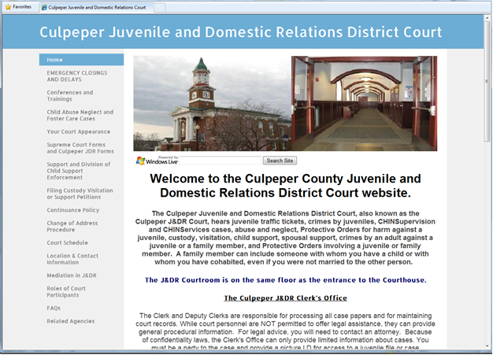


Slide 3

The Calm in the Storm:
Creating and Sustaining Best Practice
Lelia Hopper,
Court Improvement Program, Supreme Court of Virginia

Slide 4
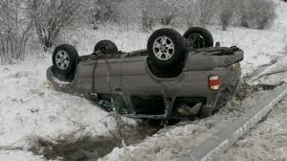

The Blizzard Survival Exercise

Slide 5
The Blizzard Survival Exercise
STEP 1 - Read the facts and complete your INDIVIDUAL RANKING of the items (without help from others).
STEP 2 - Discuss the ranking with your hiking party at your table and complete the TEAM RANKING.
STEP 3 – Obtain the EXPERTS RANKING and calculate the variance for you and the variance for your team.

Slide 6

THE PLANNING EXPERTS RANKING

Slide 7
The Blizzard Survival Exercise
1. Knife
2. Two Blankets
3. Minivan Mirror
4. Cigarette Lighter
5. Gasoline
6. Hoses
7. Metal Hubcaps
8. Spare Tire
9. Sunglasses
10. Shotgun
11. Beef Jerky
12. Shovel
13. First-aid Kit
14. Map
15. Magnetic Compass

