Slide 1

The Angry Mind
Clinically Proven
Anger Management Practices

Slide 2
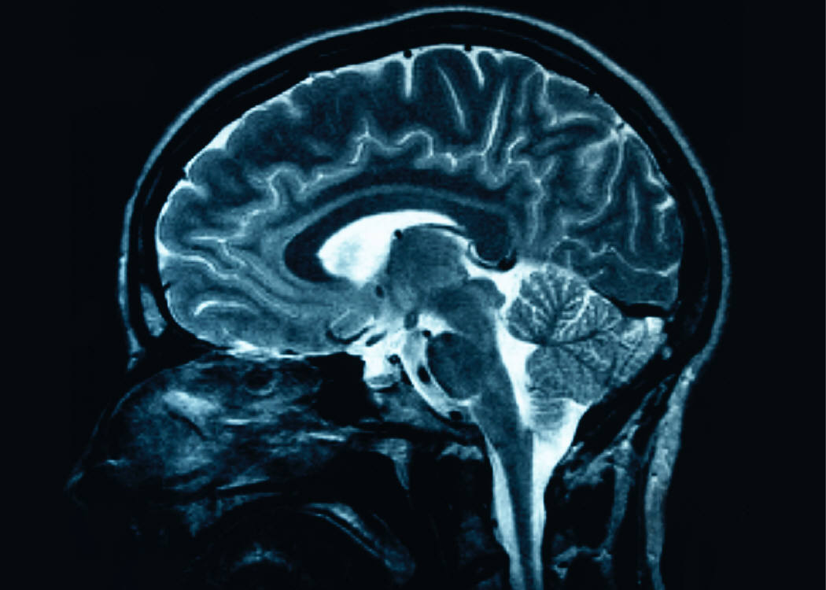
The Angry Mind
The brain immediately confronts us with great complexity. The human brain weighs only three or four pounds but contains about 100 billion neurons. Although that extraordinary number is of the same order of magnitude as the number of stars in the Milky Way, it cannot account for the complexity of the brain.
- Scientific American Gerald D. Fischbach, M.D., Neuroscientist,
Weill Cornell Medical College of Cornell

Slide 3
The Angry Mind
“Why do we get angry in the first place?”
The simplest answer is: We get angry because we are human beings. Anger is a normal human emotion. Anger is part of being human. The ability to feel anger is something we are all born with—even babies get mad. The right to feel anger is another example of a personal right. All of us are entitled to our angry feelings.
Human anger is more complex than the anger we see other animals expressing.
For example, Rover, the dog, may become angry when you pull his tail, and he may growl or bite because he feels threatened or annoyed. However, Rover will probably never get mad at himself for napping when he should have been guarding the yard. People are different. We get angry because of events, experiences, and also because of our thoughts, feelings, attitudes, and, sometimes, our own behavior.
Anger is often conceptualized as arising from either fear or pain.
The ideas of “fear” and “pain” are defined very broadly. Fear includes not just fear of something physical, but also psychological fear. For example, fear of losing face, fear of loss of esteem or regard, fear of being laughed at or appearing ridiculous, fear of being abandoned. Pain is the same. It’s more than just pain from being physically hurt. It includes emotional and psychological pain—feeling pain from someone’s words or actions, the pain of loss of love or regard, feeling pain because of life’s unfairness.

Slide 4


The Angry Mind
Definition
A psychobiological emotional state consisting of feelings varying in intensity from mild irritation or annoyance to intense fury and rage, accompanied by activation of neuroendocrine processes and arousal of the autonomic nervous system.
Complexity of Anger within the Mind and Body
Anger includes the release of brain chemicals into the body to get it ready for ‘fight’, ‘flight’, or ‘freeze’. These brain chemicals mostly consist of adrenalin and cortisol and are often experienced in the body as stress or tension as your heart beats faster, blood flows more quickly through your body, and your muscles get tense. The nervous system as well as adrenalin and cortisol signal all the organs of the body to get ready to react to the perceived threat.
Differences between Anger and Rage
Anger - goal directed
Rage - always threat directed. It is always about survival. Extreme anger and loss of consciousness They either lose whole conscious awareness for several minutes to two hours or strobe light effect remembering scenes but not the whole picture. Lack of a normal sense of self. Loss of behavioral control and inability to explain what happened or understand personally what occurred.

Slide 5
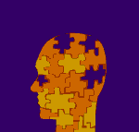
The Angry Mind
The brain is the organizational center of the broader nervous system reaching all the organs of the human body. The exciting and burgeoning field of neuroscience, although still in its toddlerhood, is wrestling with the enormous complexity of the human brain.
The human brain is made of many parts each has certain and sometimes multiple roles - to transform sounds into speech, to record emotions like anger or fear, to recognize a face, to tell the difference between a tree and a bird, or to store particular types of memory. This amazing organ is not a completely rigid kind of mass produced machine. Its different parts are both interdependent and interactive and their tasks are somewhat flexible. At times one component will take over the duty of another, or crash due to some genetic or environmental glitch. The totality of the human brain is combined in a dynamic system of systems that performs millions of assorted duties. In fact, our brain may be so complex that it will never succeed in fully understanding itself.

Slide 6
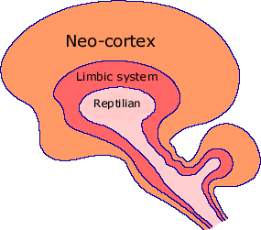

The Angry Mind
Reptilian brain
The innermost part of our brain is known as the reptilian brain. Reptilian brain is located at the base of our skull emerging from the spinal column. Amygdala is a primary structure of the Reptilian Brain and is responsible for processing the specific emotions of anger and fear. Our reptilian brain is shared with all other animals that have a backbone and maintains body functions required for sustaining life including breathing. Reptiles are cold-blooded animals warmed by the sun and thus conserve their energy by restricting activities at night. Behavior relates to survival of the species, is instinctive and responses are automatic. Territory is acquired and defended through aggression. In the world of the reptilian brain—force, power, might and strength determine success.
Mammalian brain
The mammalian brain structures are located slightly more forward region of the brain. It contains structures for the more complex automatic management of body functions such as digestion, fluid balance, blood pressure, and the autonomic nervous system (ANS), as well as for storing new experiences as memory (hippocampus). This allows for more efficient recognition of danger by relying on the memory of past experience.

Slide 7

Research Studies
Testing limits, experimenting, and acting without considering future consequences are all part of adolescent behavior according to Dr. Laurence Steinberg, Temple University. The perceived rebellious actions of teenagers that were once dismissed as changes in hormones corresponding with the beginning of puberty may actually be due to functional differences in teenage brains. The brain reaches 90 percent of its adult size by the age of 6. A second wave takes place in the years before puberty. During this time, the gray matter which is the area of the brain responsible for processing information and storing memories increases in size, particularly in the frontal lobe of the brain, as a result of an increase in the number of synaptic connections between nerve cells. Around puberty, however, a winnowing process begins in which connections that are not used or reinforced begin to wither. This pruning, which begins around age 11 in girls and 12 in boys, continues into the early or mid-20s, particularly in the prefrontal cortex, an area associated with "higher" functions such as planning, reasoning, judgment, and impulse control.
Poor connections between neurons formed during adolescence may lead to less emotional regulation as an adult.

Slide 8

Research Studies
Study conducted by Dr. Arthur Toga of the Laboratory of Neuro Imaging located at UCLA demonstrates that children and adolescents from ages 12 to 16 have less myelination in the frontal lobes of the brain. The frontal lobes, located at the front of the cranium, have been identified as the area of the brain that dictates rational behavior and reasoned weighing of consequences. Myelin is composed of neural cells that form insolating lipid layers around nerve processes. Myelinated processes can more effectively conduct electrical signals from one neuron to another. The presence of more myelin in adult frontal lobes implies that more neural processes are connecting neurons together. If connections between neurons in adolescent frontal lobes are not as abundant, adolescents may not be as capable of using their frontal lobes resulting in decreased ability to make reasoned decisions.

Slide 9

Research Studies
Dr. Jay Giedd, National Institute of Mental Health, studied the adolescent brain using magnetic resonance imaging. He identified the time between 13 and 18 when connections are made as the "use it or lose it principle." During adolescence, the amount of myelin, a fatty, insulating material that coats the axons of nerve cells increases, improving the nerve cells' ability to conduct electrical signals and to function efficiently. Nerve cells develop myelin, an insulating layer which helps cells communicate. The activities that youth participate in influence the connections made in the brain. If the neuron process connections are not properly made through sufficient stimulus, reduced function of the frontals lobes can result.
Different environmental inputs can influence the development of the youth’s frontal lobes. An individual who grows up in an environment where regulation of emotions is encouraged would be expected to have different myelinated processes than an individual where such activity is not promoted. Environmental inputs may have an important role in forming connections between neurons that leads to increased reasoning ability and self-regulation of emotional behavior.

Slide 10
Research Studies
Neuroscientist, Joseph LeDoux has empirically investigated the pivotal role of the amygdala in the specific emotion of fear and anger. The most significant result of LeDoux’s research is that sensory input to the brain is split at the relay center into two streams – one to the amygdala and one to the prefrontal cortex. The input stream to the amygdala is faster – 12 milliseconds as opposed to 25 milliseconds to the prefrontal cortex. Less information goes to the amygdala more quickly – it operates as a rapid scan to check for threats. LeDoux considers the amygdala to be the alarm system for bodily safety and survival – thus the necessity for a rapid scan and an almost instantaneous instinctive (automatic) response. The amygdala also has slower connections to the prefrontal cortex, it secondarily causes us to emotionally experience the feeling. We ‘feel’ the emotion a split-second after the physical bodily reaction. Not only is the amygdala’s response fast, it is also very influential in that it primes the whole body for action through the release of adrenaline and cortisol into the bloodstream.

Slide 11
Research Studies
Steven E. Petersen. Washington University School of Medicine . The amygdala is part of the limbic system and is responsible for emotional reactions. Dr. Richard Davidson of the University of Wisconsin-Madison found that in 500 individuals who had decreased activity in their frontal lobes, they also had decreased ability to regulate emotion. Petersen and his colleagues scanned the brains of 210 subjects ranging from 7 to 31 years old. The researchers use resting-state functional connectivity MRI to identify and study brain networks. These scans show the spontaneous activity that takes place in brains while study subjects do nothing. Researchers set the lower limit for study subjects at 7 years of age because the brain is approximately 95 percent of its adult size at this age. As a person ages, networks become more efficient and the brain can use more of them.

Slide 12
Research Findings
Confirmation that the amygdala is faster than the cognitive awareness of the prefrontal cortex is supported in part our experience of driving a car and very suddenly encountering a dangerous situation. It is possible for your foot to be on the brake before you are fully cognizant of any hazard. With the awareness of an environmental threat comes an emotional response generated in the amygdala and processed along a ‘strong’ neuronal wiring to the prefrontal cortex. As the perceived threat goes away, it can take a while for “Ok-ness” to return because the wiring from the prefrontal cortex to the amygdala is significantly ‘weaker’.
Research supports the notion that no matter what degree of control is exercised by the prefrontal cortex in terms of morals, ethics, good intentions, etc., when ‘the rubber meets the road’ in a stressful moment our body relies on the amygdala’s automatic direction.

Slide 13
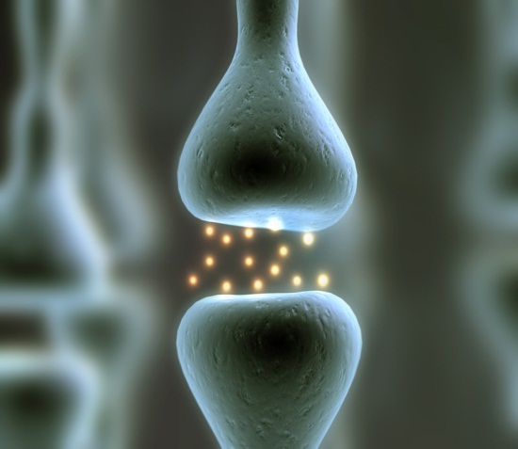
Research Findings
Neuroplasticity
Neuroplasticity is the ability of the brain to grow new neurons and rewire itself including the pruning of unused pathways, which neurologists and psychologists once believed impossible. ‘Experience’, now believed by a vast majority of neuroscientific researchers, generates various structural changes in the human brain.
Our nervous system activates the firing of neurons in response to a stimulus. This firing is similar to an electrical charge that runs down the length to the end of a neuron (brain cell) where it releases an activating or inhibiting neurotransmitter (neurochemical) at the connecting space (synapse) to the next neuron in the chain of a neuronal pathway.
There are perhaps a hundred billion neurons in the average human brain which may be connected by tens of thousands of synaptic connections. Certain neurons fire when we have an experience and a neuronal pathway develops between the various areas of the brain. These neuronal pathways may become ‘hard wired’ when we have the same or similar experiences over and over. By the time we are adults, our neuronal pathways are the result of the sum total of our ‘experience’ up to that time, as well as some basic genetic factors.

Slide 14
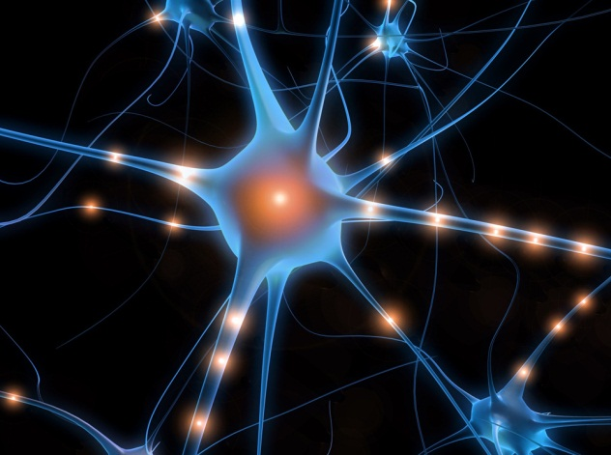
Research Findings
Research has shown that new ‘experience’ kindles the growth of new neurons (neurogenesis) from uncommitted neural stem cells. Your ‘experience’ may also cause neural firings that lead to the activation of certain genes causing them to produce proteins permitting new synapses to form and former ones to become stronger. Neuroplasticity suggests that the human mind can use the brain to change itself.
Researchers now have data supporting this notion through the use of functional scanners (fMRI) and electrical monitoring devices (EEGs). Neuroscientists are looking not only at the brain’s physical structure and activity, but also the manner in which the brain actually works as a system. These studies reveal how new experiences produce functional and structural changes in the brain itself. Neuroscientists are also capable of examining the membranes of neurons, studying neurotransmitters (chemicals that effect brain activity) and their receptors, as well as observing clusters of neurons and their immediately linked adjacent cells.

Slide 15
The Angry Mind
6 Primary Emotions
Recognized universally - Hard wired in your brain since birth
Amygdala goes online by the 8th month after conception
Mad
Sad
Glad
Scared
Surprised (startle response)
Disgust (to avoid eating poisonous things).
4 Social Emotions
Hippocampus doesn’t go online until 18 months –
Can I get my needs met? Can I trust people?
Embarrassment
Guilt-prosocial
Shame- leads to withdrawal and rage
Pride – expansive

Slide 16


The Angry Mind
Psychiatric Diagnoses with Anger Components:
Intermittent Explosive Disorder
Oppositional Defiant Disorder
Adjustment Disorder with Disturbance of Conduct
Attention Deficit/Hyperactivity Disorder
Bipolar Disorder
Conduct Disorder
Psychotic Disorder
Personality Disorders

Slide 17


The Angry Mind
10 Symptoms of People with Anger
Low Frustration Tolerance
Jealousy
Possessiveness (emotional dependency)
Controlling attitudes/demanding behaviors
Perfectionism (all or nothing)
Judgment attitudes
Poor Communication
Punitive Behavior (retaliate)
Substance abuse
Anger to gain Power

Slide 18
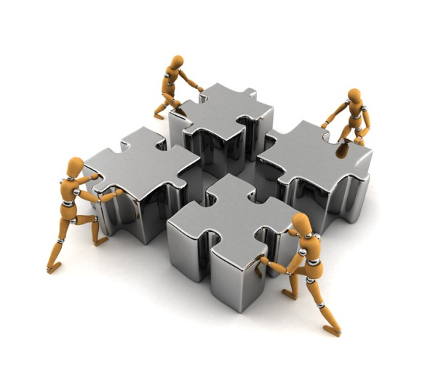

The Angry Mind
Assessment of Family Role Models
and Developmental Issues
  Shame/Narcissism
  Judgmental/Critical
  Cognitive Distortions
  Poor Conflict Resolution
  Poor Communication
  Poor Role Models
  Regression
  Trauma = Development Disturbance
Some individuals are unable to turn off the threat centers –
Constantly looking for danger.
If a traumatized person is under a lot of unending stress, the hippocampus begins burning out and loses volume. Hippocampus may have been damaged. Amygdala has been hyper sensitized.
When you are looking at someone who is quickly over activated, it is important to check for trauma history. Rage reactions – high probability they have experienced trauma.

Slide 19

The Angry Mind
5 Clear Threats to Trigger Rage
Survival Rage – triggered by unconscious processes - tremendous feeling of threat at the level of the Amygdala- “This wasn’t me. Something took me over.” Create safety, safety, safety. A person needs a safe place to heal. Try to go to the Amygdala with a few words, “I am safe now. It’s O.K.”
Impotent Rage – everyone has control over me – parents, probation officer, teacher – spontaneous rage – can’t take effective action in an area that is critical to them. Help them to take good effective action. Advocate for them to get some control back.
Shame Based Rage – can reduce us to nothingness – “You were a mistake”- attacking to shame the person. Follow the rage back to the shame- reclaim the shame. Go back to core shame messages and challenge them.
Abandonment Rage - absolutely terrified to be abandoned. “I can’t let you leave me. I will kill you if you leave me. I am nothing without you. I have no self.” Borrowed your self. That is when it get very dangerous. Homicide/suicide. Safety first. Need to make a commitment to stop raging – feel the emptiness and realize they can survive.
Outrage – Values are visceral – you perceive your deepest values being challenged.

Slide 20


The Angry Mind
Aggressive Cycle: 3 Phases
Episode of anger consists of: escalation, explosion, and post-explosion.
Escalation phase is characterized by cues that are physical, behavioral, emotional, or cognitive (thoughts). Cues are warning signs, or responses to anger-provoking events. Events are situations that occur every day that may lead to escalations of anger if effective anger management strategies are not used. Red-flag events are types of situations that are unique to the person and that the person is especially sensitive to because of past events. These events can involve internal processes (e.g., thinking about situations that were anger provoking in the past) or external processes (e.g., experiencing real-life, anger provoking situations in the here and now).
The intensity, frequency, and duration of anger in the aggression cycle vary among individuals. For example, one person’s anger may escalate rapidly while another person’s anger may escalate slowly but steadily over several hours before reaching the explosion phase. The explosion phase is synonymous with losing control.

Slide 21

The Angry Mind
Consequences of Maladaptive Anger
Physical Health
  Weakened immune system
  Inhibited GI system; reduced nutrient absorption
  Reduced, dysregulated reproductive hormones
  Increased vulnerabilities in cardio vascular system
  Disturbed nervous system
Mental Health
  Lowered mood; increased pessimism
  Increased anxiety and irritability
  Increased learned helplessness
Social and Interpersonal
  Disrupted relationships which cause isolation
Behavioral
  Involvement with the criminal justice system

Slide 22


The Angry Mind
Anger Exercise
Pair with 1 or 2 people at your table.
In the last 48 hours, what kind of anger invitations have you gotten?
We get dozens of anger invitations usually every day. Most of us have trained ourselves not to ever notice a lot of them. Which of them did you accept? Which kinds of patterns did you observe.
When angry, count to ten before you speak.
If very angry, count to one hundred.
Thomas Jefferson

Slide 23

The Angry Mind
“Roots and Tree” Concept of Anger
What do you see as helpful in thinking about anger in terms of “roots and tree” with pain and fear?
Awareness Factors
  Surroundings or environment
  Personal health
  Attitudes and expectations
When we expect things to be just, fair, honest in a world that is frequently unpredictable, unjust, unfair, and harsh, then we set ourselves up for frustration. Do you insist the world should abide by rules of fairness, justice, and “doing things right?” Do you expect you will always “win” or have things your way?

Slide 24


The Angry Mind
Why do we have brains?
To survive…to help you live longer and survive in a dangerous world.
Physical and Psychological Safety: If you are not safe you’re not going to change.
What is the threat that endangers them? What is happening in the individual’s brain that makes them feel unsafe?
SAFETY is the best anger inhibiter.
People with angry brains are very inaccurate appraisers of reality. Dr. Daniel Amen says that your Brain lies to you all the time. You should not always trust your mind. It is designed for your survival.
      When we look at photo album, we look at certain photos more frequently so when we open the album it goes to our favorites. It is not neutral. If you are chronically angry it is going to look at the angry photos.

Slide 25

Anger Response Program
*Evidence-Based Program *Latest Research *Clinically Proven Practices
Program Summary
understand the nature of their anger, the role of communication and assertiveness in their lives, brain functioning, stress-related symptoms, and the role of consequences
identifying the role of triggering thoughts, shame and narcissism, & challenge cognitive distortions
Twelve Modules Topics
*Brain Development Reactions *Conscious Awareness of Shame/Trauma
*Altering Dysfunctional Thinking *Development of Empathy
*Conflict Management *Assertiveness Training
*Cognitive Restructuring *Practical Solutions Development
*Stress Reduction Techniques *Principles of Humanity/Competence

Slide 26
The Angry Mind
3 Main Ingredients to Anger:
  Anger-eliciting stimulus (external/internal): trigger to the emotional arousal
  Pre-anger state: the mind state you are in at the moment of the anger situation whether it is calm, anxious, or chaotic
  One’s appraisal (perception): your interpretation or thinking about the situation
3 Main Methods of Dealing with Anger:
      Stuffing
      Escalating
      Managing
3 Basic Strategies:
            Cognitive Therapy
            Skills development
            Relaxation
Brain Change Plans: Combination of three requires practice, practice, practice. To make meaningful changes in your brain to redesign your brain often takes approximately 6 months.

Slide 27
References
Beck, R., and Fernandez, E. (1998). Cognitive behavioral therapy in the treatment of anger: A meta-analysis. Cognitive Therapy and Research, 22, 63-74.
Bradbury, K. E. and Clarke, I. (2007). Cognitive behavioural therapy for anger management: effectiveness in adult mental health services, Behav Cognitive Psychotherapy, 35, 201-8.
Deffenbacher, J.L., Dahlen, E. R., Lynch, R. S., Morris, C. D., and Gowensmith, W. N. (2000). An application of Beck’s cognitive therapy to general anger reduction, Cognitive Therapy and Research, 24, 689-698.
Digiuseppe, R. and Tafrate, R. C. (2002). A comprehensive treatment model for anger disorders, Psychotherapy, Theory, Research, Practice, Training, 8, 262-271.
Greene, R. W. (2010). The Explosive Child, New York: Harper Publishers.
Erwin, B., Heimberg, R. G., Schneier. F. R., et al. (2003). Anger experience and expression in social anxiety disorder: pretreatment profile and predictors of attrition and response to cognitive-behavioral treatment, Behav Ther, 34, 331-350.
Humphrey, N. and Brooks, A. G. (2006). An evaluation of a short cognitive-behavioural anger management intervention for pupils at risk of exclusion, Emotional and Behavioural Difficulties, 11 (1), 5-23.
Potter-Efron, R. (2007). Rage: A step by step guide to overcoming explosive anger, Calif: New Harbinger Publications.
Saini, M. (2009). A meta-analysis of the psychological treatment of anger: Developing guidelines for evidence-based practice. Journal of the American Academy of Psychiatry and the Law, 37, 473-488.

