Slide 1
Childhood Trauma: Beyond PTSD
The Developmental Impact of
Attachment Trauma,
Chronic Childhood Abuse and Neglect

Slide 2
Actually, on a cellular level, I’m very busy…
Infants are born with their most fully developed and largest sensory organ – skin! And ready to receive the initial stimulus to begin building neural connections.

Slide 3
DEVELOPMENTAL TRAUMA OCCURS AT CELLULAR LEVEL
Early lessons of maltreatment stored as implicit memory
Hard-wired into neurological scaffolding
Restricts various critical stages of brain structure development
Fear interrupts our ability to love
Attachment styles are generational (Hesse, 1999)
Secure attachment: “serve & return”; secure base; protective factor
Insecure – dysregulation with surrounding environment; risk factor
Avoidant : fearful, dismissive, dissociative, auto-regulating (downwards)
Ambivalent : over-activated, external regulation
Disorganized: approach/avoidant, extreme over & under regulation
75% correlation attachment styles between generations (Schore, 2000)
Early Intervention reduces generational cycles of chronic abuse
USDHHS (2002) – identified 870,000 abused/neglected children in US
83.3% abused by primary caregiver
Infants to age 3 with highest rates of victimization and death
Implications for placing children with grandparents?
Early Mental Health is neurobiological and medically necessary
Children entering Foster Care System have medical exams
Mental Health screening for all children entering Foster Care System

Slide 4
Relationships – A Matter of Life and Death!
Brains develop within the context of relationships
Brains grow over time with “bottom-up” structuring
700 new neural connections every second in first years
Connections develops template for all future relationships
Bowlby’s “Internal Working Model”
How the child expects others to treat them
How the child “trains” other to treat them
Experiences Build Brains (Video 1:57)
http://developingchild.harvard.edu/resources/multimedia/videos/three_core_concepts/brain_architecture/
Growth in nurturing and loving relationships
Mirror neurons promote empathy/sympathy
“Serve & return” relationships
“Sturdy” foundation for brain development

Slide 5
Consequences of Developmental Trauma
Neural death in chronic/toxic stressful relationships
Chronic stress restricts neural growth
http://developingchild.harvard.edu/resources/multimedia/videos/three_core_concepts/toxic_stress/ Harvard video 1:52
Unreliable responses (Tronick still face video 2:49)
https://www.youtube.com/watch?v=apzXGEbZht0
Types of stress
Positive stress – body returns to baseline
Tolerable stress – buffeted by reliable caregivers
Toxic stress – unrelieved activation of fight-flight-freeze
Maltreated kids experience increase in frequency, content, and severity than non-maltreated kids
Maltreating parents demonstrate less positive emotions
Physically abusive environments more likely to be high-intensity, aggressive, hostility and interpersonal threats.

Slide 6
Physiological Development
Sympathetic vs. Parasympathetic NS
Controls responses to environment – self regulation
Fight Flight Freeze responses
Infants, Toddlers only have the “Freeze” alternative
Toxic/chronic stress strengthens negative pathways
Positive pathways die off
Abused children primed to see anger emotion 1st
Pollak & Sinha 2002
Effects of early experience on children’s recognition of facial displays of emotion
Development of emotional lexicon (Implicit & Explicit Memory)
Identifying sadness requires more facial recognition
What is the likelihood that auditory perceptions have similar developmental patterns?

Slide 7
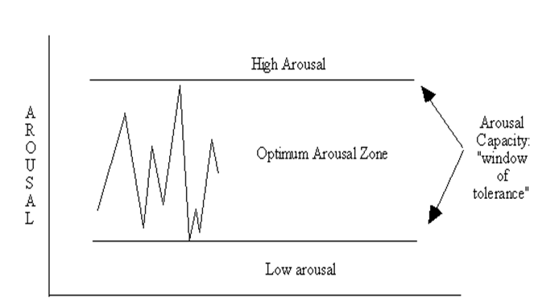
What is SELF-REGULATION?
Congruent physiological maintenance & recovery of self in context
Cognition (past, present, future), emotions, behavior, & physical homeostasis
Homeostasis begins with Attachment & Attunement – Cradle to Grave
Self & Co-regulation with primary caregiver & in all relationships
Mathias Quadruplets http://www.youtube.com/watch?v=qBay1HrK8WU
Window of Tolerance – Ogden & Minton, 2001
High Arousal: hyper-vigilence, poor impulse control, brain “offline”, hyper-arousal,
transient stability
WoT: Learning brain engaged & online; emotion lexicon,
contextual Pollack& Sinha 2002
Low Arousal: withdrawn,
avoid eye contact, low energy, freeze state, brain “offline”, hypo-arousal, transient stability
Trauma is dysregulating: it skews schemas & ways we see ourselves in our environments and the world.
What would our impressions be if the laughing babies didn’t laugh?

Slide 8
Consequences of Developmental Trauma on CNS
Co-Regulation , Self-regulation, and Auto-Regulation
What’s the difference?
Helium stick demo (4 groups of 4 to demonstrate teamwork, self- regulation and self-regulation within the context of teamwork)
Regulation dependent upon attachment style to primary caregivers
Fragile brains = fragile nervous systems
Sturdy brains = flexible nervous systems
Sympathetic Nervous System
Automatically reacts to threats – releases neurotransmitters & hormones to activate all systems: adrenaline, cortisol, etc.
Human brains are wired to constantly scan for threats
Human brains hard-wired for pro-social engagement
Alarm system activates brain and body to respond to threats
Heightened sense of awareness and arousal.
Parasympathetic Nervous System
Calms the brain and body with release of acetylcholine (neurotransmitter)
Diaphragmatic breathing
Returns the body and brain to homeostasis
Permits executive functioning to resume as the “reptilian” brain calms
Mindfulness facilitates keeping executive functioning “online”

Slide 9
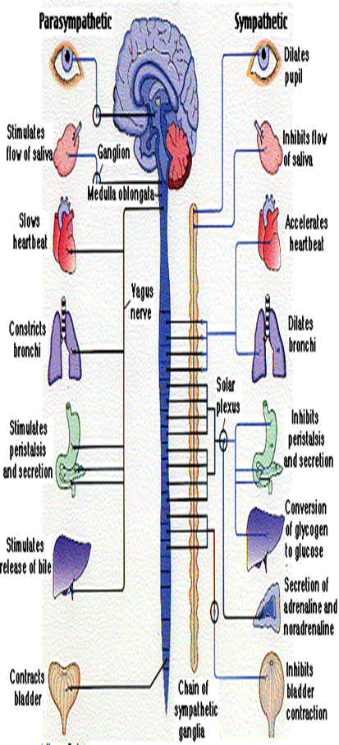
Parasympathetic & Sympathetic NS
PSNS - Preservation
Craniosacral: Bones, nerves,
fluids, spine connective
tissue, cranium
Feed & Breed: digestion &
sexual reproduction
Homeostasis: body repair,
Conserve & restore energy,
learning, decision-making and
memory remain “online”
Chemical releases:
Acetylcholine: released by
Vagus nerve, sleep, calming
& relaxing, REM sleep,
inhibitory effect in cardiac
tissue, excitatory neuro-
muscular & gastro-intestinal
muscles, supports immune
system, endorphins released
SNS – Fight/Flight/Freeze
Prepare body’s response:
*raises blood sugar, trigger
release of fats, breaks down proteins from tissue, suppresses immune system, Restricts peripheral vision
*ACE Study considerations!
Dr. James Coan study
Homeostasis is put on hold
Short-lived by design, not meant
for long term functioning; cognition impaired, learning, decision-making and proper memory-making and storage ability are “offline”
Chemical releases:
Primary stress hormones: adrenalin, norepinephrine; cortisol; depletes bodily resources, restricts limbic system use and long term flooding of chemicals restricts brain development in children and kills neurons & restricts
neuroplasticity

Slide 11
Early Interventions - Initial Assessments
Mental Health Assessments
Necessary for all children entering Foster Care System
Medical evaluations are standard procedure
CAPTA allows for EI screening thru ITC for Foster Care
Infant Toddler Connection)
MH screenings for trauma are recommended by trauma experts & researchers
EI benefits community thru reductions in crime, homelessness, eligibility-based benefit enrollments, educational remediation, etc.
Top-Down vs. Bottom-Up
For pre-verbal trauma memory is stored in neural pathways
Often referred to as “body memory”
Trauma exposed youth often have sensory integration problems
Kids may be misdiagnosed with ADHD rather than PTSD
Criteria is similar, especially with self-regulation problems
We don’t remember when we were first held but we remember how we were held.

Slide 12
Evidence Based Practices Have Experiential Component
Address pre-verbal and developmental trauma
“Amygdala whisperer” to move from auto->co->self-regulation
Trauma-exposed youth often have higher frequency
LD or DD due to “fragile” brain foundation
Underdeveloped limbic systems (emotion, memory, learning)
Stronger “negative” pathways of neural development
Neuroplasticity – the good news!
Positive goal directed physical activity integrates experiences
Incorporate physiological self-regulation into therapy
Sensorimotor Psychotherapy– Pat Ogden
Draw attention to physical sensations related to emotions
Sensory Motor Arousal Regulation Therapy SMART– Elizabeth Warner
Involves vestibular, proprioception, and other innate senses
Especially effective for sustained violent trauma
ARC – Attachment, Regulation, Competency – Blaustein and Kenniburgh
Non-directive and directive play therapy
Bio-feedback – ADHD tx

Slide 13
EBP - Experiential Component con’t.
Psychodrama – most likely in residential treatment facilities
Works in weekly group out-patient therapy
Equine Assisted Therapy – covered by most insurance
Eye Movement Desensitization and Reprocessing
Bi-lateral hemispheric processing
Simultaneous negative and positive self-beliefs
Trauma tells us something about who we believe we are
Repetitive self-narrative
Dialectical Behavioral Therapy
Combines Mindfulness, Distress Tolerance, Acceptance, Reality-testing (CBT)
Yoga –CNS regulation, self-reciprocity, mindfulness, breathing
After-school yoga programs?
Head Start?
Easy to implement in any setting
Experiential learning through repetition rewires brain
Procedural memory strengthens (long-term & implicit)
Integrate implicit and explicit memories to narrative change of IWM
Client is focus, not the trauma

Slide 15
References
Axelrod, S. R., Morgan, C. A., & Southwick, S. M. (2005). Symptoms of posttraumatic stress disorder and borderline personality disorder in veterans of Operation Desert Storm. American Journal of Psychiatry, 162, 270-275.
Blaustein, M.E., Kinniburgh, K.M. (2010). Treating traumatic stress in children and adolescents: How to foster resilience through attachment, self-regulation , and competency. New York, Guilford.
Coan, J. (2010). Adult attachment and the brain. Journal of Social and Personal Relationships, 27(2). 210-217.
Courtois, C. (2012, February). New Guidelines for the treatment of complex trauma, Chevy Chase, Md.
Felitti, V.J., Anda, R.F., Nordenberg, D., Williamson, D.F., Spitz, A.M., Edwards, V., Koss, M.P., & Marks, J.J. (1998). Relationship of childhood abuse and household dysfunction to many of the leading causes of death in adults: The adverse childhood experiences (ACE) study. American Journal of Preventive Medicine, 14(4). 245-258.
Center on The Developing Child, Harvard University. http://developingchild.harvard.edu/resources/reports_and_working_papers/

Slide 16
References
Heller, D. P. (2012 February) The neurobiology of relationships: Crossing the bridge to secure attachment and to regain resilience and richness in relationships. Networker, Symposium, Washington, DC.
Hesse, E. (1999). The Adult Attachment Interview: Historical and current perspectives. In J. Cassidy & P.R. Shaver (Eds.), Handbook of attachment: Theory, research and clinical applications (pp.395 – 433). New York: Guilford Press.
Jankowski, M.K., Leitenberg, H., Henning, K., & Coffey, P. (2002). Parental caring as a possible buffer against sexual revictimization in young adult survivors of child sexual abuse. Journal of Traumatic Stress, 15(3), 235 – 244.
Luxenberg, T., Spinazzola, J., Hidalgo, J., Hunt, C., & van der Kolk, B. A. (2001a). Complex trauma and disorders of extreme stress (DESNOS) part one: Assessment. Directions in Psychiatry, 21(25), 373-393.
Luxenberg, T., Spinazzola, J., Hidalgo, J., Hunt, C., & van der Kolk, B. A. (2001b). Complex trauma and disorders of extreme stress (DESNOS) part two: Treatment. Directions in Psychiatry, 21(26), 395-414.
Ogden, P. & Minton, K. (2000). Sensorimotor psychotherapy: One method for processing traumatic memory. Traumatology VI(3).

Slide 17
References
Renaud, E. F. (2008). The attachment characteristics of combat veterans with PTSD. Traumatology, 14(3), 1 – 12.
Rovi, S., Chen, P.H., & Johnson, M.S. (2004). The economic burden of hospitalizations associated with child abuse and neglect. American Journal of Public Health, 94, 586-590.
Schore, A. N. (2000). Attachment and the regulation of the right brain. Attachment & Human Development, 2(1), 23-47
van der Kolk, B. A., Roth, S., Pelcovitz, D., Sunday, S., & Spinazzola, J. (2005). Disorders of extreme stress: The empirical foundation of a complex adaptation to trauma. Journal of Traumatic Stress, 18(5), 389-399.
Wang, C.T., & Holton, J. (2007). Total estimated cost of child abuse and neglect in the United States. Economic Impact Study, 1, 1-5.
Wesselmann, D., & Potter, A. E. (2009). Change in adult attachment status following treatment with EMDR: Three case studies. Journal of EMDR Practice and Research, 3(3), 178-191.
Wolf, G. K., Reinhard, M., Cozolino, L. J., Caldwell, A., & Asamen, J. K. (2009). Neuropsychiatric symptoms of complex posttraumatic stress disorder: A preliminary Minnesota multiphasic personality inventory scale to identify adult survivors of childhood abuse. Psychological Trauma: Theory, Research, Practice, and Policy, 1(1), 49-64.

